Slide 1
Comparing the Biomechanics Between a Flat and Topspin Forehand
Rakesh Goli
BIOL 438
4/29/14

Slide 2
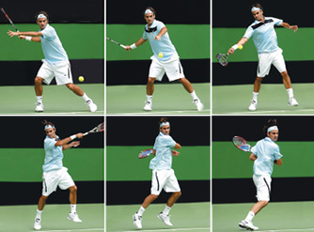
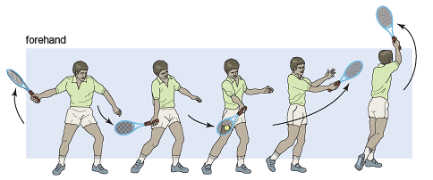
Introduction
The Forehand and Backhand comprise the essential “ground strokes” essential for success during a rally
Generally the first learned stroke
Grips – Western → Semi-Western → Eastern
Dependent on Player Preferences, same grip for both strokes
http://www.optimumtennis.net/inside-out-forehand-shot.htm
http://kids.britannica.com/comptons/art-54080/Both-the-forehand-and-backhand-strokes-are-hit-in-smooth

Slide 3
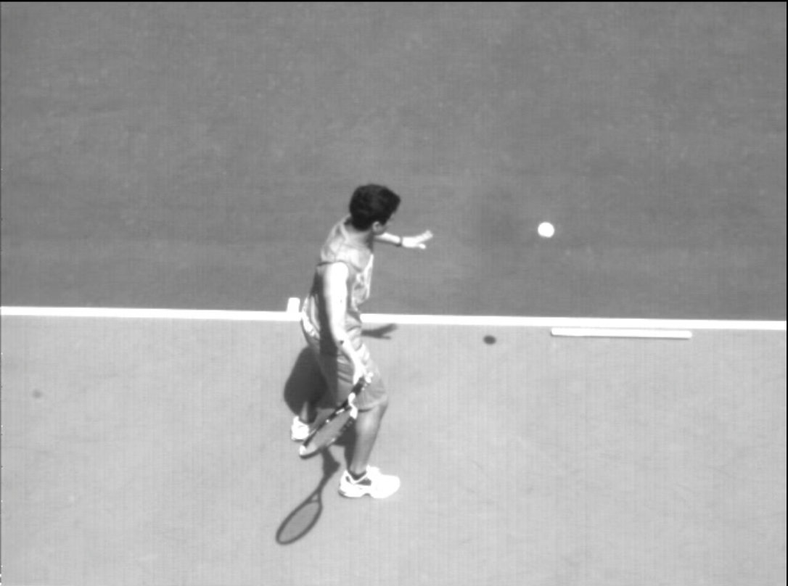
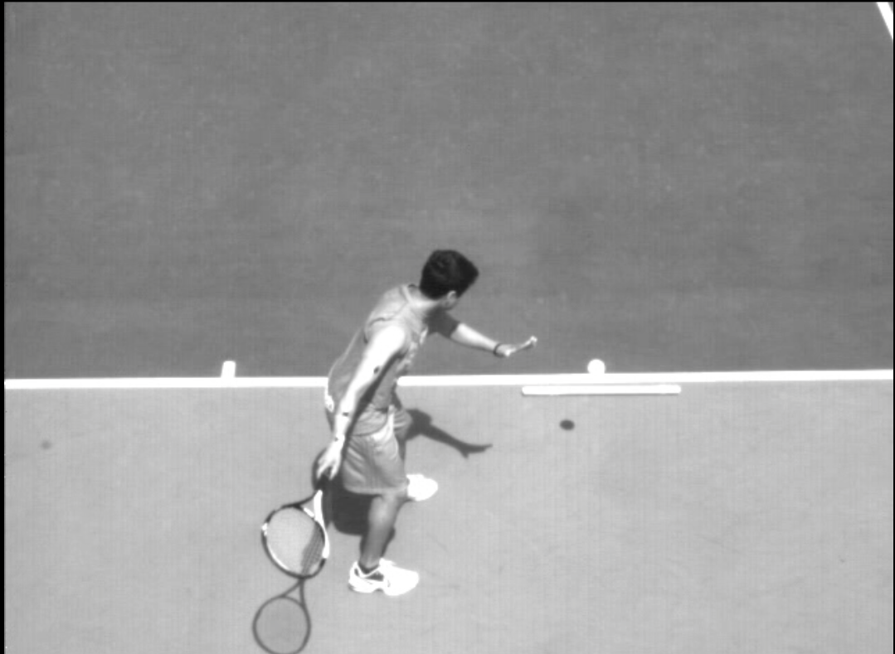
Phases of Forehand Stroke
1. Preparation/Loading
Stepping - For a right hander this means that the left foot is positioned horizontally with the toe and ball ideally forming a line parallel to the baseline
Takeback – The racket is drawn back in a c shape. This is accomplished by the right deltoid and biceps. Different players have modified takebacks for rhythm purposes
Flat Forehand
Topspin Forehand

Slide 4
Phases of Forehand Stroke Contd.
2. Hitting the Ball
1. Hip rotation towards the ball (counterclockwise rotation for right handers)
Muscles: Right Gluteus maximus and medias
2. Elevation – Help get the ball over the net
Muscles: Leg Extensor Muscles, Left and Right Soleus, Quads, Gluteus Maximus
3. Arm Swing of the Racket
Muscles: Right Pecs, Deltoids, and Biceps
4. Wrist Flexion to generate extra power and spin for topspin forehand
Muscles: Right Palmar Flexors
Phase 4 Encompasses Phase 3

Slide 5
Questions
Which of the two forehand strokes (flat vs. topspin) requires a larger energy expenditure?
How much does each segment of the swinging arm contribute to producing ball kinetic energy in the ball?
Looked at Upper Arm, Forearm, Wrist/Hand, and Racket COM
Is there a difference in Racket/Ball Contact Time between the two strokes?
Which shot is more energetically efficient?

Slide 6
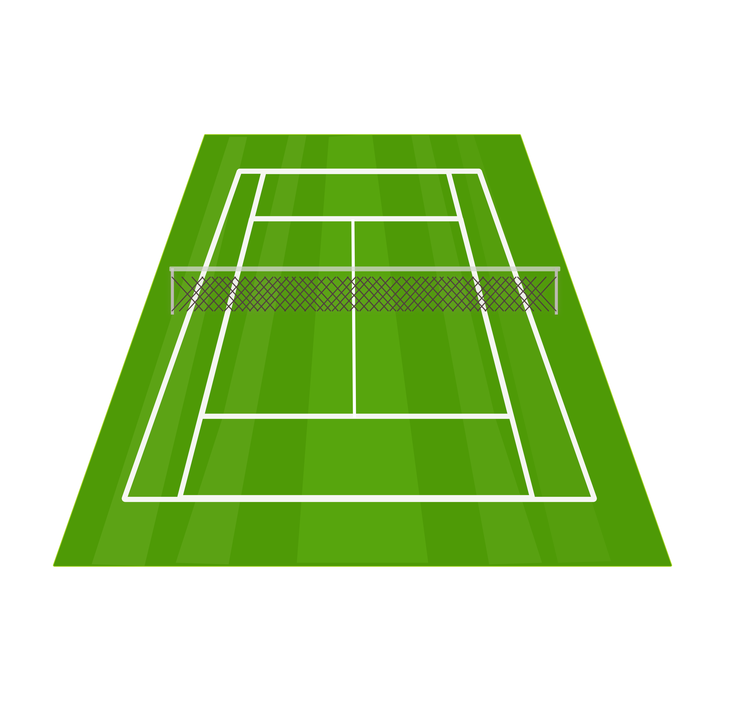
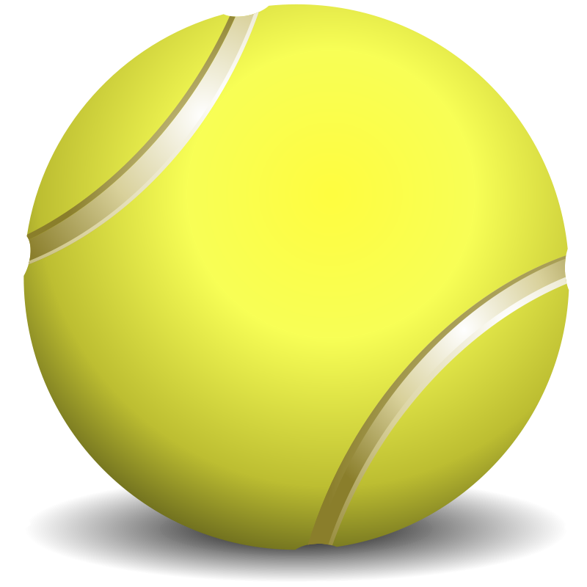
Assumptions
Did not consider side to side movement of ball when hitting stroke, but only looked at vertical velocity
Did not consider X velocity of ball, but figured into movement of limb segments
Assumed that my mass is 145 lbs exactly = 65.91kg / Mass of a tennis ball is 0.057kg
My lower body did not contribute anything to force and energy generation
All energy from Upper Arm-to-Racket system. Not necessarily true because there is hip rotation/leg movement, but done for simplicity purposes
Ball was hit at similar position on court for both strokes
Angle that the video was filmed at
Start
http://www.clipartlord.com/category/sports-clip-art/tennis-clip-art/tennis-ball-clip-art/
http://clipartist.info/openclipart.org/2011/June/25-Saturday/tennis_court.svg.html

Slide 7
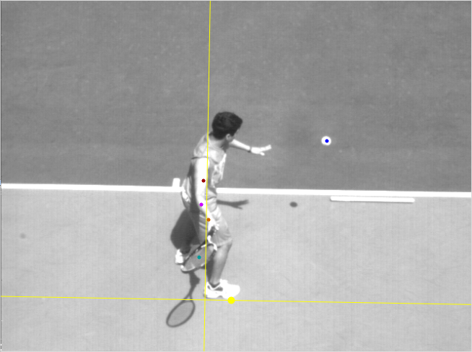
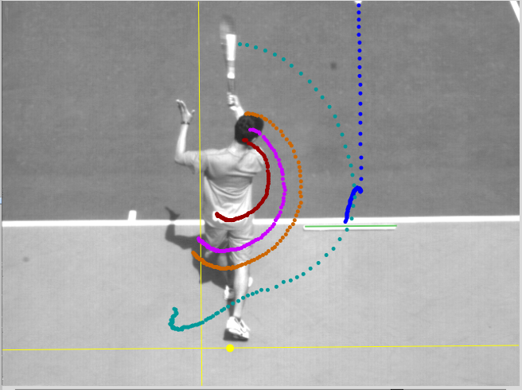
Analysis
Components Analyzed
Ball Acceleration/ Velocity
Force/Power/Energy of Ball
Time of Contact
Time for Second Phase
Velocity of Segments
Percent Contribution from Segments
Efficiency of Flat vs. Topspin Stroke

Slide 8
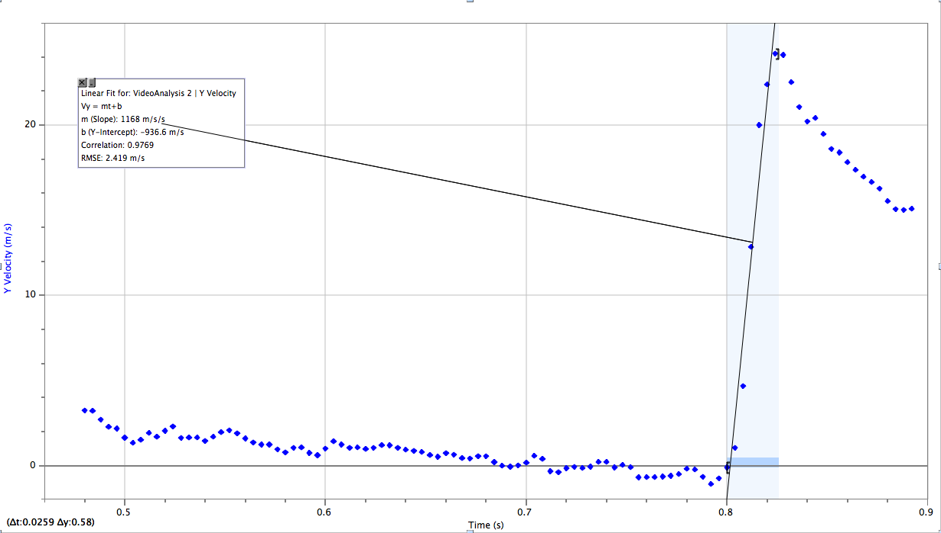
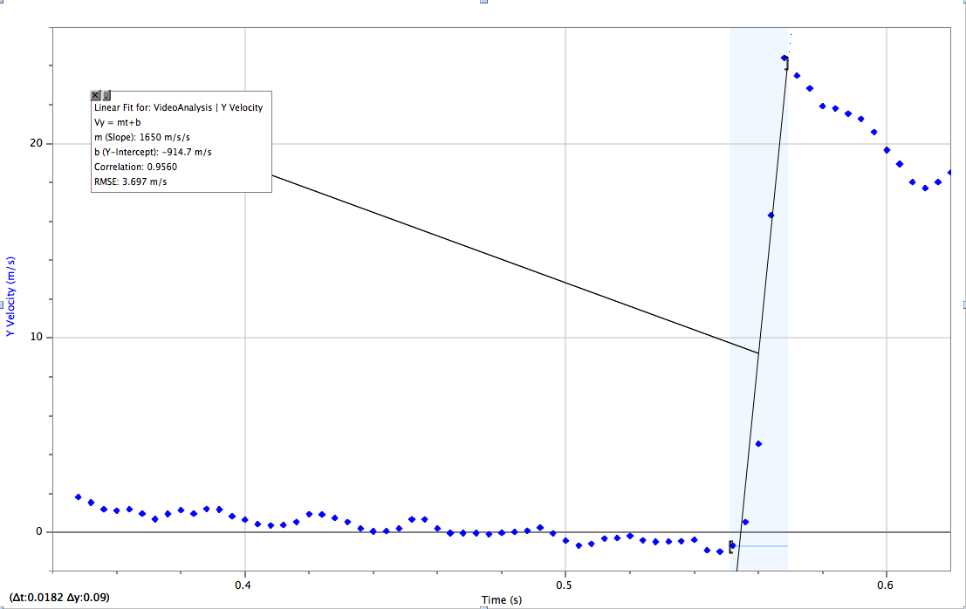
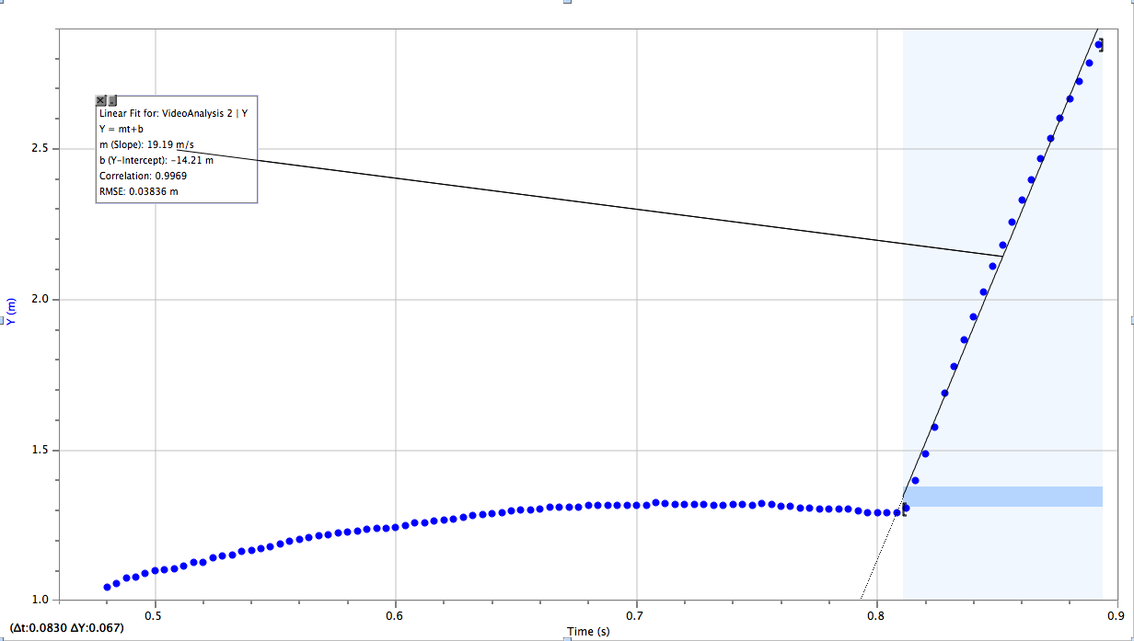
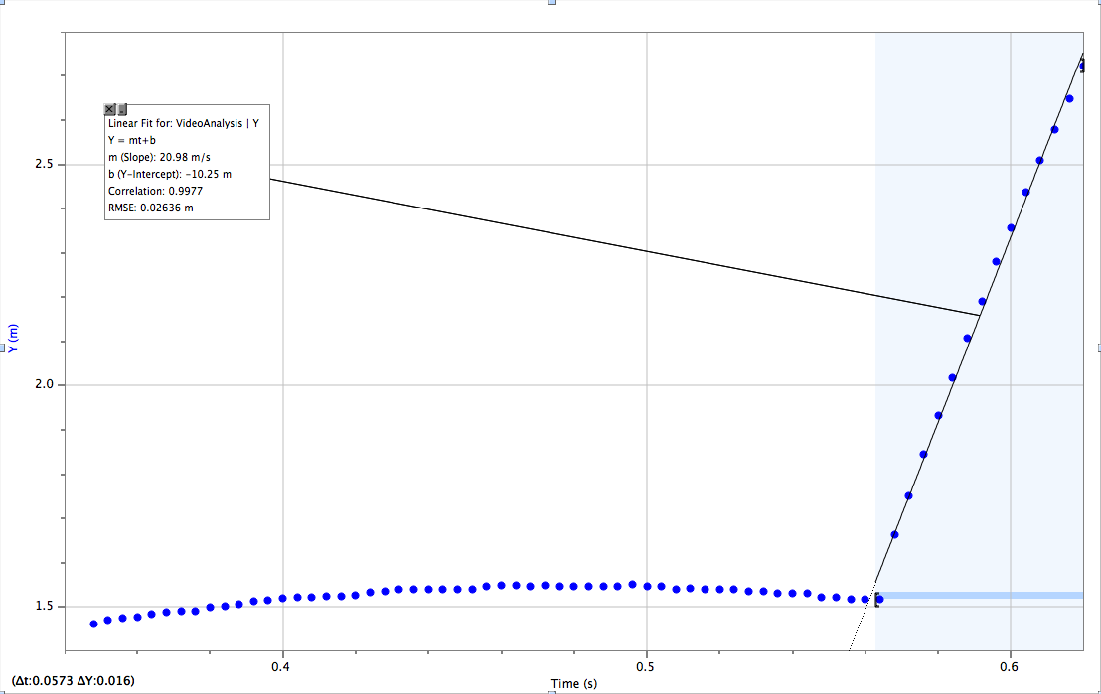
Physics of Tennis Ball
Flat Forehand:
Topspin Forehand:
Acceleration = 1168 m/s²
Acceleration = 1650 m/s²
Avg. Velocity after Contact = 19.19 m/s
Avg. Velocity after Contact = 20.98 m/s
1. Ball Acceleration / Velocity

Slide 9
Analysis Contd.
 | Flat Forehand | Topspin Forehand
Force of Ball after Contact | 66.58 Newtons | 94.05 Newtons
Kinetic Energy of Ball | 10.49 Joules | 12.54 Joules
Power | 405.019 Watts | 689.011 Watts
Flat Forehand:
Topspin Forehand:
Force:
F = m*a = (0.057 kg) (1168 m/s²) =
66.58 Newtons
Kinetic Energy:
KE = 0.5(m)(v²) = (0.5)(0.057 kg)(19.19m/s)² = 10.49 Joules
Power:
Power = KE/Δt = (10.49 J)/(0.0259 s) = 405.019 Watts
Force:
F = m*a = (0.057 kg) (1650 m/s²) =
94.05 Newtons
Kinetic Energy:
KE = 0.5(m)(v²) = (0.5)(0.057 kg)(20.98m/s)² = 12.54 Joules
Power:
Power = KE/Δt = (12.54 J)/(0.0182 s) = 689.011 Watts
2. Force / Power / Energy of Ball

Slide 10
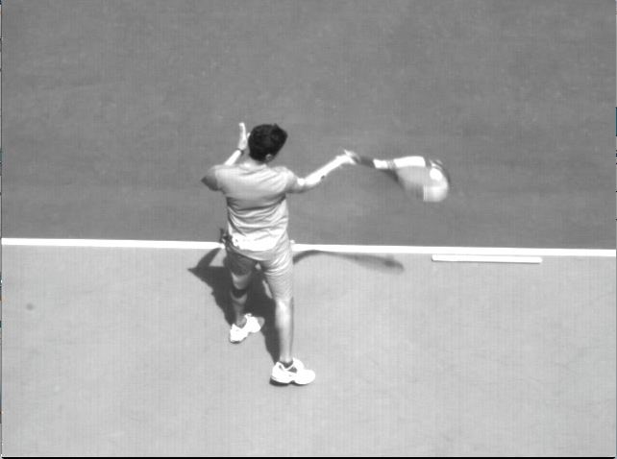
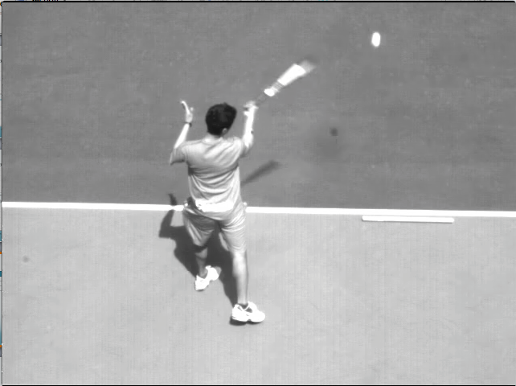
Analysis Contd.
 | Flat Forehand | Topspin Forehand
Time of Racket-Ball Contact | 0.026 sec | 0.018 sec
Time for Second Phase | 0.404 sec | 0.284 sec
Velocity After Contact | 19.19 m/s | 20.98 m/s
3. Time of Racket-Ball Contact / 4. Time for Second Phase

Slide 11
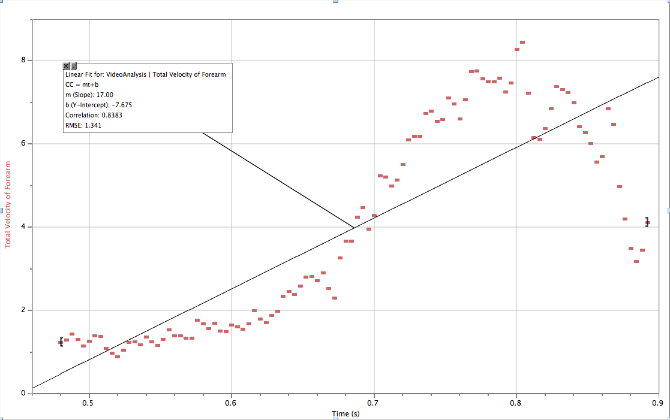
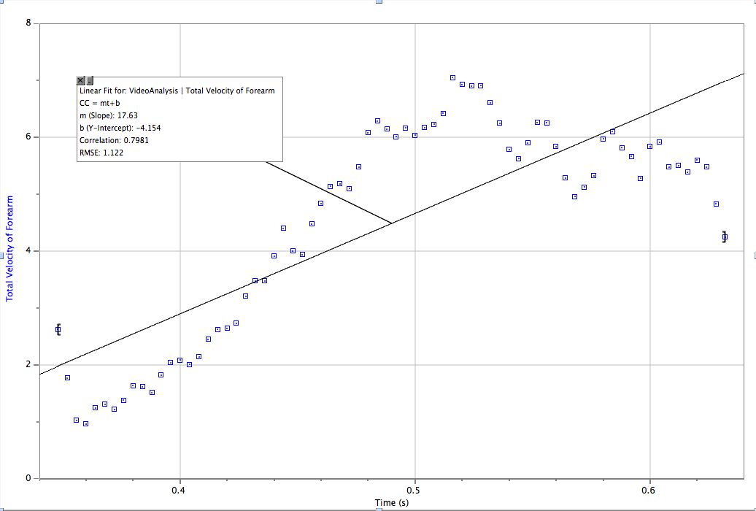
Physics of Upper Body
Flat Forehand:
Math:
Midpoint of Flat Forehand Stroke (0.69 s)
Avg Velocity of Forearm = ( .69)(17.11) – 7.758
Flat Forehand:
Avg Velocity of Upper Arm = 2.61 m/s
Avg Velocity of Forearm = 4.05 m/s
Avg Velocity of Wrist/Hand = 5.327 m/s
Avg Velocity of Racket COM = 9.72 m/s
Avg. Total Velocity (X and Y Direction) = 4.05 m/s
Topspin Forehand:
Topspin Forehand:
Avg Velocity of Upper Arm = 2.64 m/s
Avg Velocity of Forearm = 4.48 m/s
Avg Velocity of Wrist/Hand = 5.922 m/s
Avg Velocity of Racket COM = 11.34 m/s
Avg. Total Velocity (X and Y Direction) = 4.48 m/s
5. Velocity of Upper Body Segments/Racket

Slide 12
Physics of Upper Body Contd.
Flat Forehand:
Topspin Forehand:
Kinetic Energy of Each Segment:
Upper Arm:
0.5(m)(v²) = 0.5(1.786)(2.61²) = 6.08 J
Forearm:
0.5(m)(v²) = 0.5(1.07)(4.05²) = 8.77 J
Wrist/Hand:
0.5(m)(v²) = 0.5(0.40)(5.327²) = 5.68 J
Racket COM:
0.5(m)(v²) = 0.5(0.299)(9.72²) = 14.12 J
________________________________
Total Energy = 34.65 Joules
Kinetic Energy of Each Segment:
Upper Arm:
0.5(m)(v²) = 0.5(1.786)(2.64²) = 6.22 J
Forearm:
0.5(m)(v²) = 0.5(1.07)(4.48²) = 10.74 J
Wrist/Hand:
0.5(m)(v²) = 0.5(0.40)(5.922²) = 7.01 J
Racket COM:
0.5(m)(v²) = 0.5(0.299)(11.34²) = 19.23 J
________________________________
Total Energy = 43.2 Joules
+
+
Plagenhoef, S, 1983
6. Velocity of Upper Body Segments/Racket

Slide 13
Stroke Efficiency
 | Energy | % Energetic Contribution
FLAT FOREHAND | 34.65 J | N/A
Upper Arm | 6.08 J | 17.55 %
Forearm | 8.77 J | 25.31 %
Wrist/Hand | 5.68 J | 16.39 %
Racket | 14.12 J | 40.75 %
Efficiency of Stroke = (Ball Energy) / (System Energy) = (10.48 J) / (34.65) = 30.27%
 | Energy | % Energetic Contribution
TOPSPIN FOREHAND | 43.20 J | N/A
Upper Arm | 6.22 J | 14.40 %
Forearm | 10.74 J | 24.86 %
Wrist/Hand | 7.01 J | 16.23 %
Racket | 19.23 J | 44.51 %
Efficiency of Stroke = (Ball Energy) / (System Energy) = (12.54 J) / (43.20) = 29.03%
7. Efficiency of Stroke

Slide 14
Questions
Which of the two forehand strokes (flat vs. topspin) requires a larger energy expenditure?
Topspin Forehand (43.2 J vs. 34.65 J for Flat Forehand)
How much does each segment of the swinging arm contribute to producing ball kinetic energy in the ball?
Racket contributes the most, then forearm
Wrist more than upper arm in topspin, less in flat
Is there a difference in Racket/Ball Contact Time between the two strokes?
Longer racket-ball time and longer second phase time for flat forehand
Which shot is more energetically efficient?
Flat forehand (30.27% vs. 29.03% for Topspin Forehand) – not a very large difference

Slide 15
Future Directions
I would like the repeat the analysis multiple times to have statistical confidence in the data
Different body positions and its effect on the stroke and biomechanics (I looked a square stance). Look at open stance and inside out or inside in stance.
In open stance, you feel more energy expenditure in upper body and less contribution from lower body, so see if that is true
See the effects of jumping on both a topspin and flat forehand?
Would expect there to be more of a lower body contribution
Analyze these components in different stokes (previous project looked at slice).
Would like to see this analysis for a volley or for a lob so see how the biomechanics change

Slide 16
References
Bahamonde, R. E., and D. Knudson. "Kinetics of the upper extremity in the open and square stance tennis forehand." Journal of Science and Medicine in Sport 6.1 (2003): 88-101.
Elliott, Bruce, Tony Marsh, and Peter Overheu. "A biomechanical comparison of the multisegment and single unit topspin forehand drives in tennis." International Journal of Sport Biomechanics 5.3 (1989): 350-364.
Elliott, Bruce. "Biomechanics and tennis." British Journal of Sports Medicine 40.5 (2006): 392-396.
Knudson, Duane, and Rafael Bahamonde. "Effect of endpoint conditions on position and velocity near impact in tennis." Journal of Sports Sciences 19.11 (2001): 839-844.
Plagenhoef, S., Evans, F.G. and Abdelnour, T. (1983) Anatomical data for analyzing human motion. Research Quarterly for Exercise and Sport 54, 169-178.

