Slide 1
Biomechanics of a Boxing Punch
Hank Bryant
University of Pennsylvania
BIOL 438: Systems Biology

Slide 2
A Little Boxing History
Ancient Sumeria 3rd Millennium BCE
First known depiction of boxing
Minoan Crete 1500-900 BCE
First evidence for fist fighting with gloves
Ancient Roman Amphitheaters
Banned in 393 AD
Resurfaced in London in late 17th Century
Bare-knuckle boxing or “prizefighting”
Illegal in U.S. and UK for much of 19th and early 20th century
Legitimized in middle to late 20th century
Now: 12 rounds, extreme amounts of money spent each year

Slide 3
Dangers of Boxing
Cuts, bruises, and broken teeth, ribs, and other bones
Boxer’s fracture
Internal bleeding and damage to organs
Eye injuries
Retinal detachment and hemorrhage
Brain damage – decreased grey and white matter
Alzheimer’s
Dementia
Parkinson's

Slide 4
Muscles Involved
Pectoralis Major
Most active when elbow is elevated (hook)
Deltoids – guarding and throwing punches
Anterior – most active; works with pecs in synergistic fashion to maximize force
Medial – active when arm is lifted for a right cross or left hook
Posterior – active when pulling arm back from a punch
Triceps Brachii – snapping elbow straight
Biceps - guarding
Core and waist – taking punches and swiveling

Slide 5
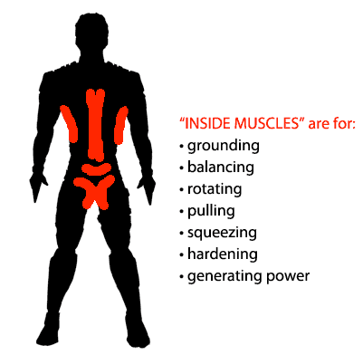
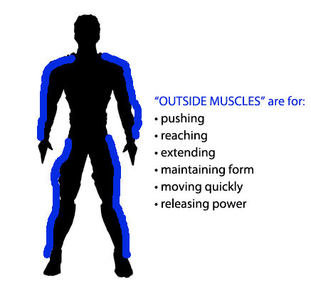
Muscles Involved
Back muscles – punch retraction
Traps, rhomboids, and rear deltoids
Legs – footwork, balance, and torque
Quads and glutes – slip or roll under or around punch
*Neck*
Trapezius
Omohyoid
Stemohyoid
Sternocleidomastoid

Slide 6
Boxing Motion

Slide 7
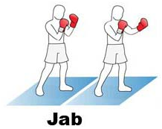
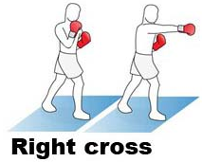
Types of Punches Analyzed
Jab
Fastest path to opponent
Requires east amount of effort
Right Cross
Dominant hand
Power of torque from trunk
Hypothesis:
Right cross will have increased velocity, acceleration, and force

Slide 8
Methods
iPhone 6S at 240 FPS
Logger Pro
Microsoft Excel for graphs and data analysis
Adidas Soccer Ball – mass of 0.43kg
TITLE Boxing Gloves
Rope
Plastic grocery bag – mass of .0055kg

Slide 9
Biomechanics and Calculations
Force = mass x acceleration
F = ma
Velocity = distance/time
v = m/s
Acceleration = velocity/time
a = m/s²
Mass Conversions
Hank’s body mass = 78.47kg
Arm mass (7.6% of body mass) = 5.97kg

Slide 10
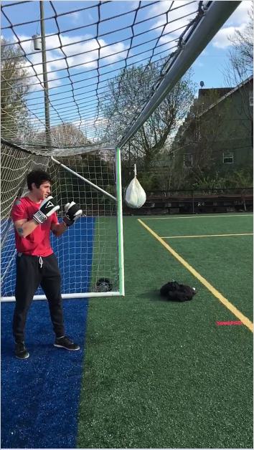
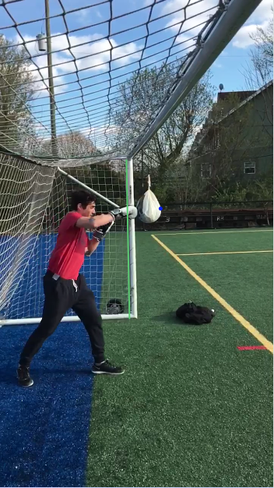
Right Cross Analysis

Slide 12
Right Cross: Ball Velocity

Slide 13
Right Cross: Elbow Velocity

Slide 14
Right Cross: Wrist Velocity

Slide 15
Right Cross: Wrist Displacement

Slide 16
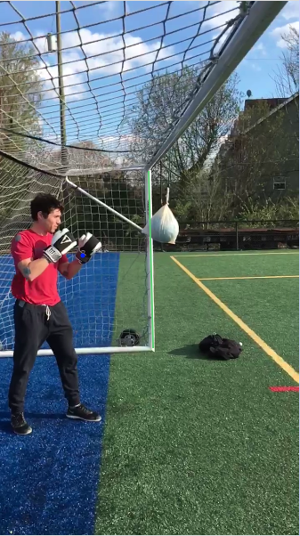
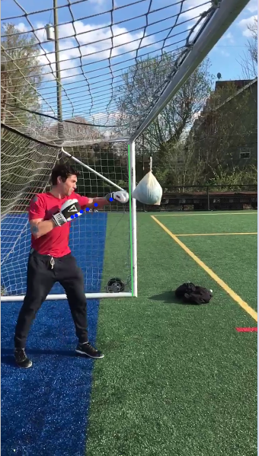
Left Jab Analysis

Slide 18
Left Jab: Ball Velocity

Slide 19
Left Jab: Elbow Velocity

Slide 20
Left Jab: Wrist Velocity

Slide 21
Left Jab: Wrist Displacement

Slide 22
Punch Comparison
 | Ball Velocity | Ball Acceleration | Elbow Velocity | Elbow Acceleration | Wrist Velocity | Wrist Acceleration | Wrist Displacement | Impact Force
Right Cross | 7.91 | 263.67 | 7.9 | 48.47 | 7.95 | 48.77 | 1.57 | 291.16
Left Jab | 7.54 | 94.25 | 4.09 | 40.85 | 6.53 | 40.81 | 1.06 | 243.64
*All values were calculated for the x-direction

Slide 23
Conclusions
Don’t get in a fight with boxer, MMA fighter, or karate professional
Right cross generates more velocity, acceleration, and force
Torque from body swivel
Weight transfer
Engagement of additional muscle groups like lats, trapezius, core, etc.
Additional energy required
However, jab requires less time to execute
More punches per time interval
Right cross requires more commitment
Leaves the body more vulnerable to attack
One punch may be more beneficial as a counter in different situations

Slide 24
Facts
The average person generates about 1/10 – 1/5 the amount of force of pros
Average force of karate black belt punch – 325 lbs (1,446N)
687lbs of force need to break concrete slab 1.5 inches thick
Ivan Drago of Rocky IV measured 2,150 psi – 8,600 lbs
Amazing, but impossible
1985 study of Frank Bruno (World Boxing Council Heavyweight Champ) – 920 lbs
Extrapolated to a real life blow of 1,420 lbs, this accelerates his opponent’s head to 53 g – 53 times the force of gravity

Slide 25
Improvements
Evaluate a better boxer
Better technique = better results (force, velocity, power, etc.)
Minimize environmental conditions
Less wind
Find alternative to plastic bag as it may slow the ball significantly
100% x-direction punch
Translate all energy into the horizontal force
Some lost to vertical
Minimize friction of the rope
Fully elastic collision => complete transfer of energy

Slide 26
Future Experiments and Directions
Look into calculations of Momentum, Torque, Impulse, etc.
How can one maximize power while minimizing energy exertion?
Some fights last many rounds….less energy now = more power later
Timing of different punches
Don’t want to throw all of one punch
All about STRATEGY – know which punches to throw when
How does footwork come into play?
Torque utilization
Does hand size matter?
Increased surface area for bigger hands
Acceleration is more important than mass
Teach boxer’s with slower speeds to hit faster => increased force

Slide 27
References
https://kmccready.wordpress.com/2014/02/25/boxing-and-nz-health-authorities/
http://www.livestrong.com/article/525164-muscles-that-get-stronger-from-boxing/
http://www.expertboxing.com/boxing-training/boxing-workouts/why-lifting-weights-wont-increase-punching-power-part-2
http://www.liveforlifetraining.co.uk/services/boxing/the-big-5-boxing-punches/
http://www.livestrong.com/article/538379-how-to-measure-force-on-a-punching-bag/

