Slide 1
Analyzing differences between a First and Second Serve in Tennis
Parth Shah
Biology 438
April 19, 2011

Slide 2
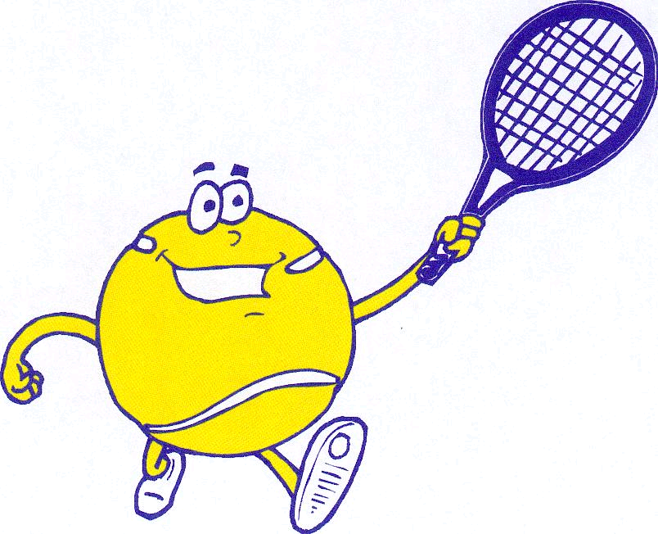
Tennis: A sport
Tennis is a sport that uses several different muscles groups in different types of strokes:
Forehand
Backhand
Slice
Serves
The most complex motion, according to experts, is the Serve, which is the focus of my discussion today.

Slide 3
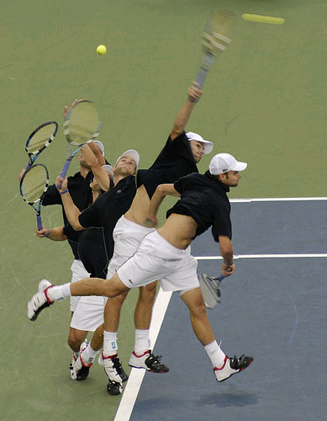
Serve: what are they and why do we care?
Serves are a series a complex of muscles movements that I discuss later
Serves are important part of the game because % of first and second serves has a significant effect on the outcome of the game.
Professionals tend to have a faster serve (presumably with more power) than their 2nd serves due to the fact that if the 2nd serve does not go in, the player automatically loses that point.
Top 10 Players usually have serves greater than 150km/hr to make it difficult for the opposing player to return the serve, which is has been shown by research.

Slide 4
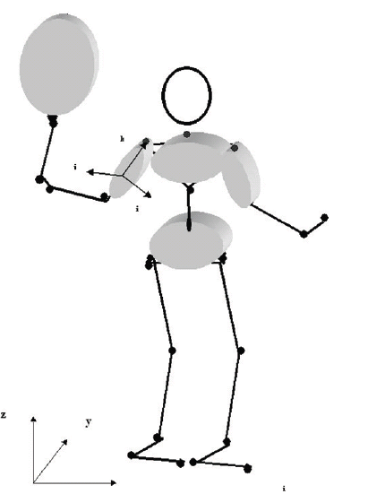
Serves: How does it happen?
Serves involve a motion of different body parts in a very precise fashion, that contribute to the racquet speed:
1) the shoulder external rotation
2) the wrist extension
3) the twist rotation of the lower trunk
4) the twist rotation of the upper trunk,
5) the shoulder abduction,
6)the elbow extension,
7) the ulnar deviation rotation
8) the second twist rotation of the upper trunk
9) the wrist flexion.

Slide 5
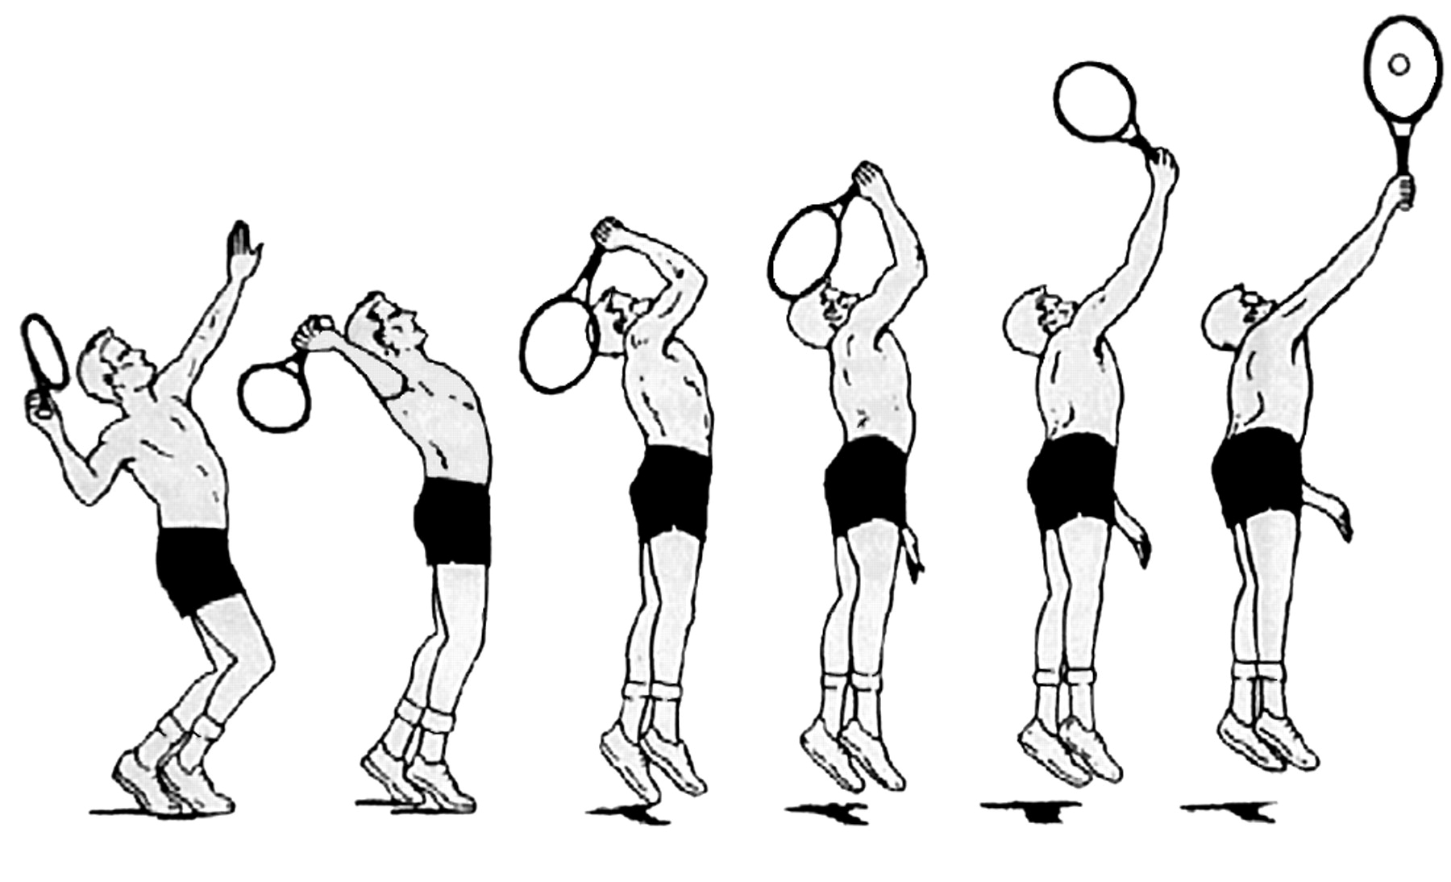
Serve: A more visual way to think about it
Cocking
Acceleration
Deceleration & then follow-through

Slide 6
Hypothesis
Since serves are important part of the game, I am particularly interested in differences between first and second serves:
Hypothesis I: Does the player (me) generate less power and force in the 2nd serve than in the 1st serve?
Hypothesis II: Does the (%) kinetic energy transferred to the ball in the 2nd serve lower than that is transferred to the ball in the 1st serve?

Slide 7
First serve (Flat Serve)

Slide 8
Second serve (Top Spin heavy serve)

Slide 9
First (flat) serve: Force
Head TiS5
Mass = 0.252kg
Radius=0.6875m

Slide 10
First Serve: Energy of Racquet
Instant Before Impact
Instant After Impact

Slide 11
First serve: energy of the ball

Slide 12
First serve: energy Transfer

Slide 13
Second serve: Force
Head TiS5
Mass = 0.252kg
Radius=0.6875m

Slide 14
Second serve: energy of racquet
Instant Before Impact
Instant After Impact

Slide 15
Second Serve: Energy of Ball

Slide 16
Second serve: energy Transfer

Slide 17
Power
First Serve
Second Serve

Slide 18
angular velocity
First Serve: 4.088-4.212: 0.124s
Travelling π radians
Angular Velocity = π /0.124 = 25.34ω
Second Serve: 3.680-3.752= 0.072s
Travelling π radians
Angular Velocity = π /0.072 = 43.63ω

Slide 19
Results
 | 1st Serve | 2nd Serve
Kinetic Energy of Racquet Before Impact (J) | 42.48 | 110.58
Kinetic Energy of Racquet After Impact (J) | 11.56 | 55.33
Difference in Kinetic Energy (J) | 30.92 | 55.25
Kinetic Energy of Ball After Impact (J) | 28.61 | 19.26
Potential Energy of Ball After Impact (J) | 1.31 | 1.12
Potential Energy of Ball Before Impact (J) | 1.32 | 1.12
Total Energy Transferred (J) | 28.60 | 19.26
% Energy Transferred | 93% | 35%
Speed of Ball After Impact (m/s) | 31.69 | 26.00
Force (Centripedal) (N) | 97.94 | 254.94
Angular Velocity (ω) | 25.34 | 43.63
Power (Watts) | 3865 | 3425

Slide 20
so, what does the data say…
The 2nd serve (top-spin) transfers less % Energy to the ball from the racquet than the 1st serve (flat).
The 2nd serve generates more force and angular velocity than the 1st serve.
The velocity of the ball in the 2nd serve is lower than that in the 1st serve.

Slide 21
conclusions
Why did the % of Kinetic Energy Transfer drop off sharply in the 2nd serve?
Unlike the first serve, the 2nd serve is a top spin serve. This implies that the racquet grazes the ball, and more of the energy is transferred to the ball’s rotational velocity than linear velocity. This explains why the tennis ball in the top-spin serve has a lower speed than the flatter serve.
Why might the 2nd serve generate more force than the 1st serve?
At first, it might not seem intuitive (it clearly wasn’t to me since I made the opposite direction), but we can probably attribute it to the fact that a much lower % of Energy is transferred to the ball in the top-spin serve than in the flat serve. In order to have some acceptable velocity in addition to the extra spin, the 2nd serve might need to generate more force

Slide 22
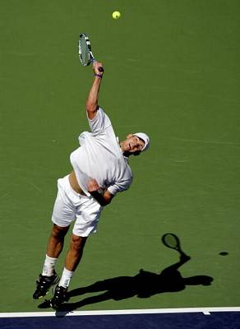
comparisons
Vs.
First Serve Speed~ 67.5mph
First Serve Speed~ 155mph
Not even half as good → still close to an average tennis player (~ 70mph)

Slide 23
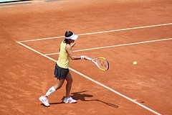
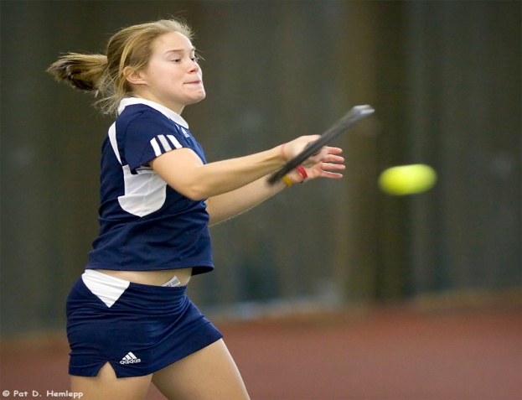
Future investigations
Compare a top-spin forehand with a flat forehand for the observable differences.
It would be interesting to see whether there is a similar difference in the % energy transferred to the ball compared with the force generated on both of those shots

Slide 24
References
Konda, Shoji, Toshimasa Yanai, and Shinji Sakurai. "Scapular Rotation to Attain the Peak Shoulder External Rotation in Tennis Serve." Journal of the American College of Sports Medicine. 42.09(2010): 1745-1753.
Kibler, William, T Jeff Chandler, Robert Shapiro, and Michael Conuel. "Muscle activation in coupled scapulohumeral motions in the high performance tennis serve." British Journal of Sports Medicine. 41.11 (2007): 745-749.

Slide 25
Any Questions?

