Slide 1
The Biomechanics of Hula Hooping
Dasha Donado
Biol-438
Professor Rome

Slide 2
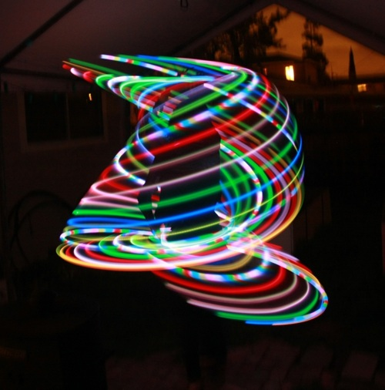
History
Greeks invented Hula Hoop as a form of exercise
1300’s- popular toy in Great Britain
1800’s- British sailors witnessed hula dancing in Hawaiian Islands
Hula dancing and hooping are similar– name Hula Hooping
Today, one of the most popular toys.
In fact, I would hula hoop for long periods of time when younger.
Notes:
Why hula?

Slide 3
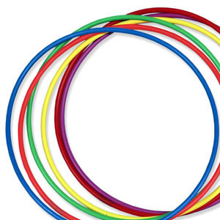
Questions of Interest
How much kinetic energy is needed to keep a hula hoop aloft?
How much work is being done by the hips?
How much additional energy are the hips adding to the hoop?
What is the centripetal force of the hula hoop?
Notes:
How much force is required to keep the hoop at a specific height (oppose for of gravity)?
How much energy are the hips inputting into the system to keep hoop rotating at waistline
What is the change in Kinetic Energy between rotations (net amount of work)?

Slide 4
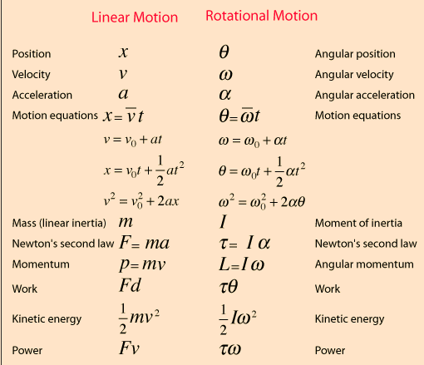
Definitions And Parallelism
Definition
Rotational- Linear Parallel
Work-Energy Theorem-
W=∆KE (J)
The work done by the net force acting on a body results change only in its kinetic energy.
Angular Velocity
ω= ∆Θ/∆t (radians/s)
Linear Velocity
V= ∆x/∆t (m/s)
Kinetic Energy (J)
Energy of motion
Potential Energy (J)
Energy of position
PE=mgh
Centripetal Force (N)
a force which keeps a body moving with a speed along a circular path and is directed along the radius towards the centre.
F= (mv^2)/r
Moment of Inertia (kg*m^2)
I=mr^2

Slide 5
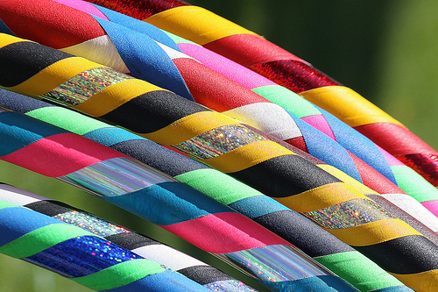
Background Knowledge
Hips doing upward work.
Opposing gravity.
Work can only be done if there is a force and distance.
Work done in x direction by hip
Calculated through KE lost/acquired by hoop
Work done in y direction by hips
Work done by hoop is horizontal. Side to side motion of hips but varies by person
Flexor and extensor
movement and power of the ankles, knees , hips and joints.
Requires coordinated use of multiple body segments.

Slide 6
Muscles used
Buttocks
Hips-
When move in one direction, you contract those muscle and extend the ones in the other direction.
Legs
Ankles
Notes:
Butt Is used because as you are contracting the muscles in the butt as you move your hips. Helps with stability.
Hips are used because there is a contractinc and extending of the muscles depending on what side moving
Legs because you are moving them from side to side as well as the hip so muscles extend and contract
Ankes more as your hip moves
Some peopl euse one muslce more than other and depending on what you wanna work pout you can change it.

Slide 7
Rotation Intervals
Rotation# | Frames | Angle (radians) | ∆t (s) | Average height (m)
1 | 848-1011 | 2π | .652 | 1.1191
2 | 1012-1189 | 2π | .712 | 1.0639
3 | 1190-1446 | 2π | 1.028 | 1.1502
4 | 1447-1630 | 2π | .736 | 1.0656
5 | 1631-1874 | 2π | .976 | 0.9049
6 | 1875-2237 | 2π | 2.428 | 0.6726
7 | 2238-2291 | π/4 | .216 | 0.3196
No Hip Motion Starting Here
Important Numbers
Radius | .4316 m
Mass of Hoop | .6804 kg
Mass of Hips | 7.6013 kg
Moment of Inertia (I) | 0.12686 kg*m^2

Slide 8
Video

Slide 9
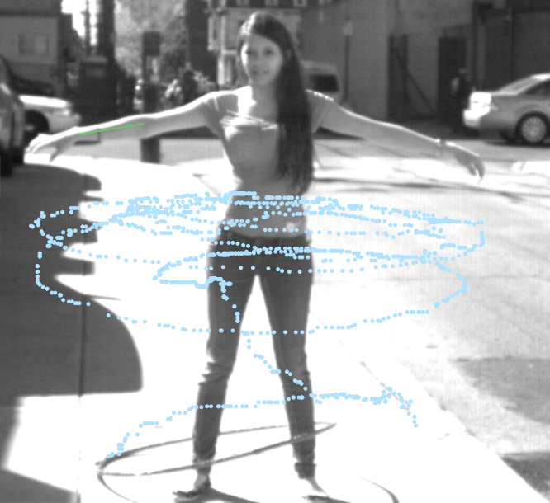
Angular Velocity of Hoop
Hoop has a general trend of slowing down as it falls.
Rotation | Angular Velocity (radians/s)
1 | 9.6368
2 | 8.8247
3 | 6.1121
4 | 8.5369
5 | 6.4377
6 | 2.5878
Notes:
Slows down as it falls.
However, possible that hoop gained momentum right before right before the hips stopped.
The positioning or location of the hoop on the hip could have affected the energy of the hoop when stopping and hoop coud have gained energy quickly (from all that was released from hip).– since energy is conserved

Slide 10
Interesting Observations
Because it was tilted down when falling, hoop sped up.
Quick drop
Shape of body
Once full contact again, angular velocity of hoop slows down because of rubbing friction with the leg.

Slide 11
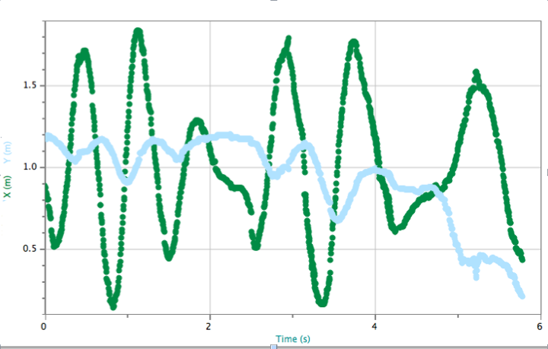
Linear Velocity
Hoop
Linear Velocity in Y-direction for rotation 1-3 is approximately 0 because there is no change in velocity as hoop only moving in X-direction.
In rotation 4-6, the Linear Velocity gets more negative because its speeding up in negative direction.
Rotation 6, in Vx, is almost 0 because there is little to no movement in the x direction, most is in the Y.
Vx- allows us to see that once hip motion stops, the hoop doesn’t make a full rotation in the x-direction but rather begins to rapidly drop in the y-direction.
Graph shows that a little after 4 second the graph fails to swing forward and goes flat (mostly dropping).
Rotation # | Vx (m/s) | Vy (m/s)
1 | 0.052842636 | -0.036548136
2 | -0.014388378 | -0.005342867
3 | -0.055331861 | 0.010626823
4 | 0.319476364 | -0.04161265
5 | -0.200198651 | -0.183182961
6 | 0.002849221 | -0.393479319
Notes:
In why slight up and down movement in hoop but goes in negative and possitive direction.

Slide 12
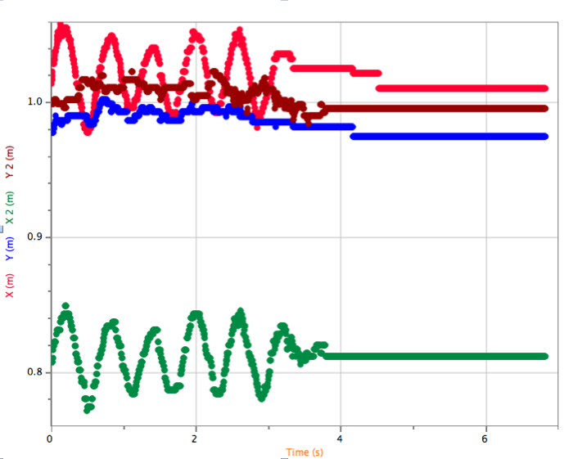
Linear Velocity
Hip
Hip and Rotation | Vx (m/s) | Vy (m/s)
left
1 | 0.2644 | 0.0558
2 | 0.1832 | 0.0639
3 | 0.1882 | 0.0394
right
1 | 0.2308 | 0.0669
2 | 0.1784 | 0.0789
3 | 0.1787 | 0.0584
After rotation 3, hips stop motion, therefore, no linear velocity in the X or Y because no change in distance.
Vx: Rotation 1 to 2: hips slow down (preparation for fill stop) so movement in x-direction decreases.
Vy: hips slow down, thus, less movement in Y-direction.

Slide 13
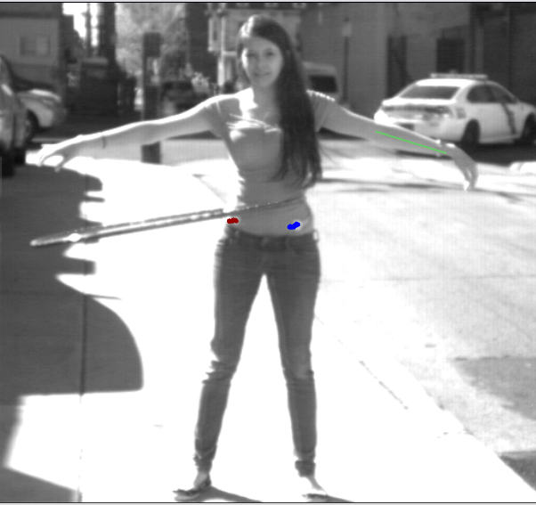
Rotation | acceleration | Force hoop | Force Hip
4 | -0.07097 | -0.04829 | 0.04829
5 | -0.14505 | -0.09869 | 0.09869
6 | -0.08661 | -0.05893 | 0.05893
Average Force Hips |  |  | 0.06864
Force on the Hip
Hip needs to oppose the force of gravity (mg) so the acceleration found allows us to calculate the force at which the hoop falls (in free fall).
Force of freefall is equal and opposite to force of Hip.
Acceleration negative once hip stop motion because hoop slowing down as it moved down.
Average force Hips need to do in rotations to keep it from falling.
KE Hips
∆KE is the amount of additional KE required from the hips.
∆(KE_{r—}KE₁)= Work tells us how much work the hips were moving relative to the first rotation.
Fairly constants for each hip through rotations.
Moving and working to keep hoop in motion at same position.
Difference between hips because one could potentially move more than the other.
Left use to make more motion and right used for stability
left | X-Direction | Y- Direction | Rotations | ∆KE (J) | Rotations (r) | ∆(KE_{r—}KE₁) =Work (J)
1 | 0.26569 | 0.01183 | 2 to 1 | 0.13814 | 2 to 1 | 0.13814
2 | 0.12756 | 0.01552 | 3 to 2 | -0.00706 | 3 to 1 | 0.13108
3 | 0.13462 | 0.00590
Average | 0.17596 | 0.01108
right
1 | 0.20246 | 0.01701 | 2 to 1 | 0.08149 | 2 to 1 | 0.08149
2 | 0.12096 | 0.02366 | 3 to 2 | -0.00041 | 3 to 1 | 0.08109
3 | 0.12137 | 0.01296
average | 0.14826 | 0.01788
Notes:
Hip need to oppose the force of mg so acceleration found leads to lead what force falls at so leads to force needed to keep up.
Work is the same because while in motion it is basicallycontanst:
Change in KE is the amount of

Slide 14
Kinetic Energy in Hoop and Work (x-direction)
Angular
Only Hoop because hips moving side to side and not in a circular motion.
Only in X-direction because circular motion in X not Y.
∆KE= Work. Is work done for each rotation
Linear
Almost no KE because moves in positive and negative x-direction
Velocity almost zero
Rotation | angularKE (J) | linearKE (J) | Total KE (J) | rotation | ∆KE _{within rotations} (J) | rotation | ∆KE=Work (J)
1 | 5.891 | 0.001 | 5.892 | 2 to 1 | -0.952 | 2 to 1 | -0.952
2 | 4.940 | 0.000 | 4.940 | 3 to 2 | -2.569 | 3 to 1 | -3.521
3 | 2.370 | 0.001 | 2.371 | 4 to 3 | 2.287 | 4 to 1 | -1.234
4 | 4.623 | 0.035 | 4.657 | 5 to 4 | -2.015 | 5 to 1 | -3.249
5 | 2.629 | 0.014 | 2.642 | 6 to 5 | -2.218 | 6 to 1 | -5.467
6 | 0.425 | 0.000 | 0.425
Average KE in first three rotations: 4.401 J
average amount of KE in hoop while hips in motion.
Notes:
Work done by hip is negative when stop.
WORK DONE BY HIP-use by calculating the initial KE of hoop when not stoping then after stop, the kinetic energy difference is the amount of work

Slide 15
Potential Energy, Linear Kinetic Energy of Hoop (y-direction) and Work
Rotation | Potential Energy | Linear Kinetic Energy | E=PE+KE | Rotation | ∆E= Work (J)
1 | 7.462 | 0.000 | 7.463 | 2 to1 | -0.369
2 | 7.094 | 0.000 | 7.094 | 3 to 1 | 0.207
3 | 7.669 | 0.000 | 7.669 | 4 to 1 | -0.357
4 | 7.105 | 0.001 | 7.106 | 5 to 1 | -1.417
5 | 6.034 | 0.011 | 6.045 | 6 to 1 | -2.925
6 | 4.485 | 0.053 | 4.538
There appears to be some work in the Y direction.
Work gets more negative as the hoop stops because it is more in free fall so more work being done from gravity.
Change in energy is the amount of work because the energy is being transferred throughout the system from hips to hip but one hips stop, then there is an outside force (gravity) and friction acting on the hoop.
Energy starts as Potential and starts converting to Kinetic.
Notes:
There appears to be no work because I am taking into account a full rotation rather than each inividual value and height.
No work in Y because Pe + KE= total E . Closer study of hip movement would be needed.
There appears to be work
Linear (in y direction is potential and kinetic in y) total e
total amount of work being done is from gravity. Starts as potential and convert to kinetic

Slide 16
Centripetal Force
Rotations | Force | Centripetal Velocity
1 | 27.259 | 4.159
2 | 22.858 | 3.809
3 | 10.965 | 2.638
4 | 21.392 | 3.685
5 | 12.165 | 2.779
6 | 1.966 | 1.117
Inward force that keeps hoop moving around.
Typically decreases with each rotation.
However, increases in first rotation with no movement of hips.
Possible explanation: More force needed to keep it moving in circle rather than falling straight down.
Velocity increases to allow the motion to continue.

Slide 17
Future Study
Effects of momentum on the system.
Further analyze why when I stopped, the velocities and force increase
Nature or me?
Change in pattern in rotation 4
Multiple trials
More accurate tool for measuring the rotations
Use smaller angles of rotation to analyze
Do analysis in 3-D.
Calculate % of Energy Transferred from Hip to Hoop in each rotation.
Effects of Friction

Slide 18
Conclusion
Conclusion
Energy going into the hoop is equal to how quickly the hoop loses energy when hips are stagnant.
The difference in Kinetic Energy for each rotation (in the hoop) after stopping of hips, compared to that when hips in motion (the KE of the hoop when hips in motion and hoop in original place), is the amount of work.
The hips are doing work opposing the force of gravity and drag to keep the hoop in motion to stop from falling.
Hips add energy to the system
Friction force helps slow down the hula hoop when hoop in contact with body.
The amount of Kinetic Energy needed to keep the hoop from falling is the average KE of the hoop when hips still moving.
The energy of the hoop determines the energy being added by the hips.
Work in the X and Y direction
Work in the X is KE rotational and linear of hoop
Work in the Y is potential and kinetic linear of hoop.

Slide 19
Data Summary
Amount of Work done by Hips |  |  | Amount of Energy needed to keep hoop Up | Kinetic Energy lost every rotation |  | Average Work done by hips through whole movement of hula hoop (when hips in motion and when faltered)
Rotation | X-Direction KE_{tot}=KE_{ang}+Ke_{lin} ∆KE_{tot}= Work (J) | Y- Direction E_{tot}=KE_{lin}+PE ∆E_{tot=} Work (J) | X-Direction Hips still moving | X-Direction |  | Average ∆KE= Work in Hoop in X-Direction
 |  |  |  | Rotation | Joules
2 to 1 | -0.952 | -0.369 | Average KE in first three rotations: 4.401 J | 2 to 1 | -0.952 | -2.8846 (J)
3 to 1 | -3.521 | 0.207 |  | 3 to 2 | -2.569
4 to 1 | -1.234 | -0.357 |  | 4 to 3 | 2.287
5 to 1 | -3.249 | -1.417 |  | 5 to 4 | -2.015
6 to 1 | -5.467 | -2.925 |  | 6 to 5 | -2.218

Slide 20
References
http://hyperphysics.phy-astr.gsu.edu/hbase/mi.html
http://www.exrx.net/Kinesiology/Segments.html
University Physics by Young and Freedman

Slide 21
Fun Fact
Great exercise. 15 min hula hooping (exercise kind)= 3 miles of jogging
Exercises multiple muscles at a time
Can exercise one more than other depending on how much emphasis you put on the muscle.
Can buy heavier hoops for better workout.

