Slide 1
Muscle Function and Kinematics of Dart Throwing
William Chow
April 12, 2012

Slide 2
Introduction
Darts is an accuracy game
Speed-accuracy trade-off
Many versions of darts
American darts
Archery darts
Cricket
Dart golf
Round the clock
Fives
Halve it
Killer
Shanghai
Notes:
Speed accuracy tradeoff usually due to time/distance constraint
Rules of cricket: The goal of cricket is to be the first player to open all the cricket numbers and have a higher point total.
Cricket uses the numbers 15 to 20 and the bullseye

Slide 3
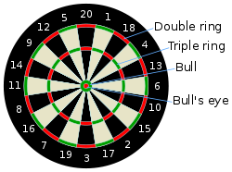

Slide 4
Stretch shortening cycle
Active stretching of a muscle followed by an immediate shortening of the same muscle
Notes:
Debate over the increased benefit associated with muscle contractions that take place during SSC. Some postulate that the performance enhancement occurs due to elastic structures in series with the contractile component can store energy (like a spring)

Slide 5
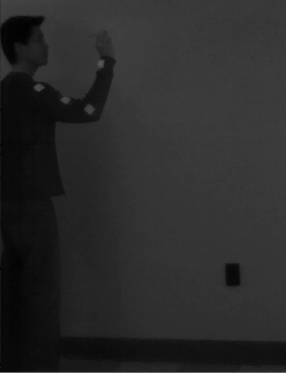
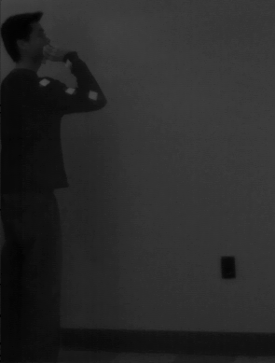
Preparation phase
Increases the acceleration path of the object
Increases length of muscles responsible for the action
Notes:
Prep puts the body into an advantageous position
1.6->2.2 total of 0.6 seconds

Slide 6
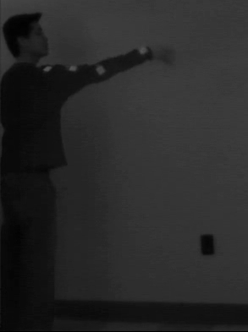
Action phase
Range of motion principle
Elbow extension and wrist radial/ulnar deviation with slight shoulder flexion
Notes:
Range of motion principle- less range of motion is most effective for low effort and high accuracy movements.
A dart player stabilizes most of the joints of the body with isometric muscle actions, and limits the dart throw to a small range of motion focused on elbow and wrist.

Slide 7
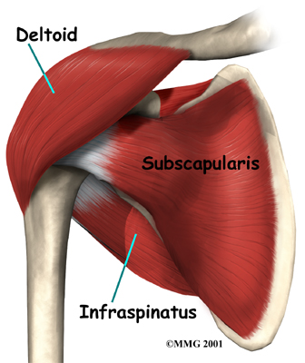
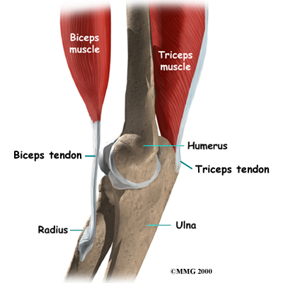
Important muscles
Notes:
Shoulder flexion- moving the upper arm upward to the front. Mainly using deltoids (specifically anterior and some lateral) and some biceps
Elbow extension- first biceps contract in prep. The triceps contract during extension

Slide 8
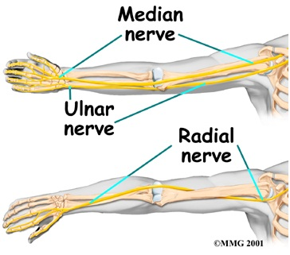
Important muscles

Slide 9
Displacement vs Time
Total time = 0.42 seconds
Distance traveled (horizontally) = 2.528m
Initial height = 1.579m Release point = 1.823m
Max height = 1.941m Final height = 1.854m

Slide 10
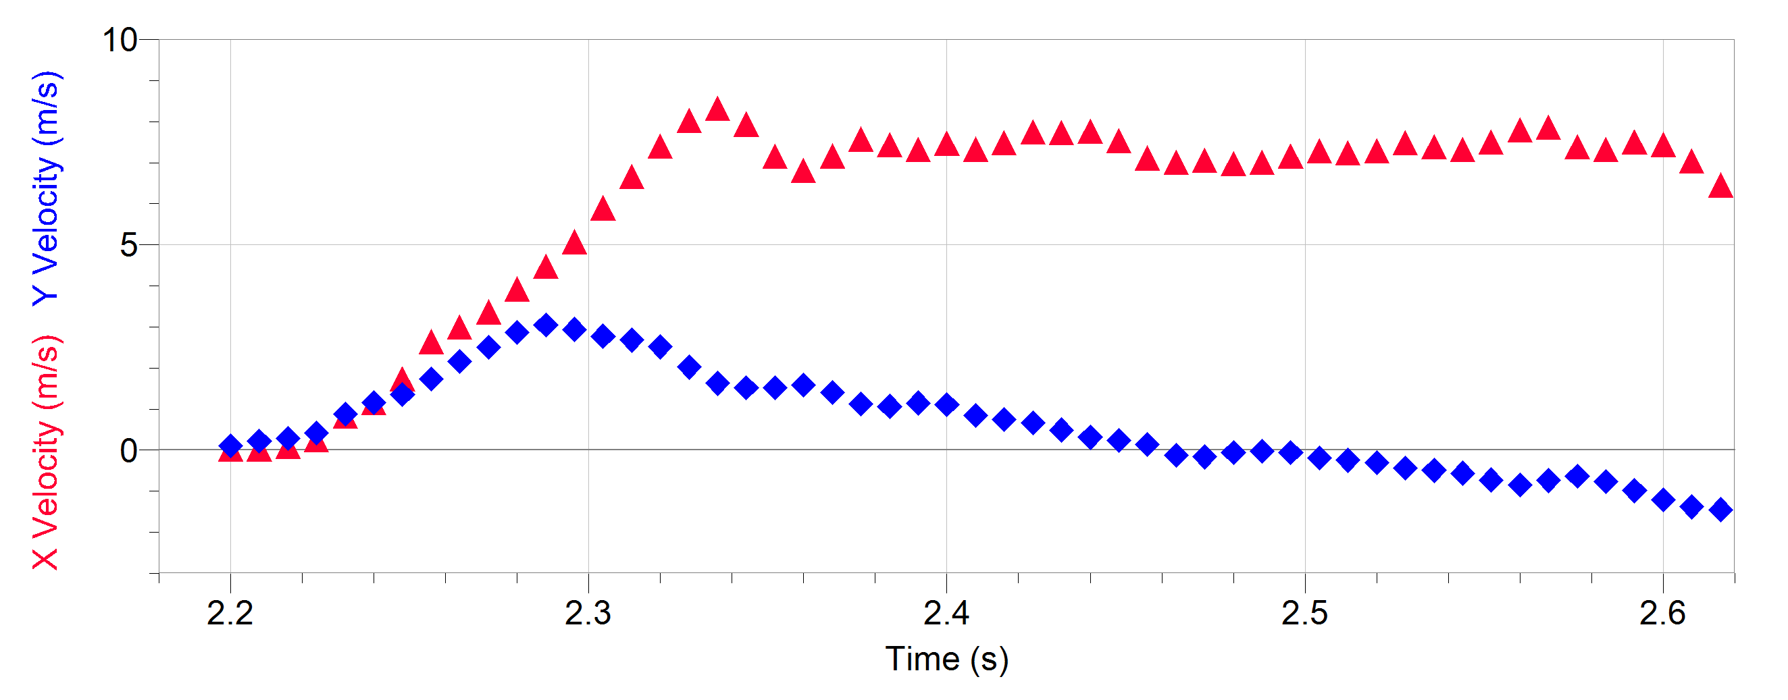
Velocity vs Time

Slide 11
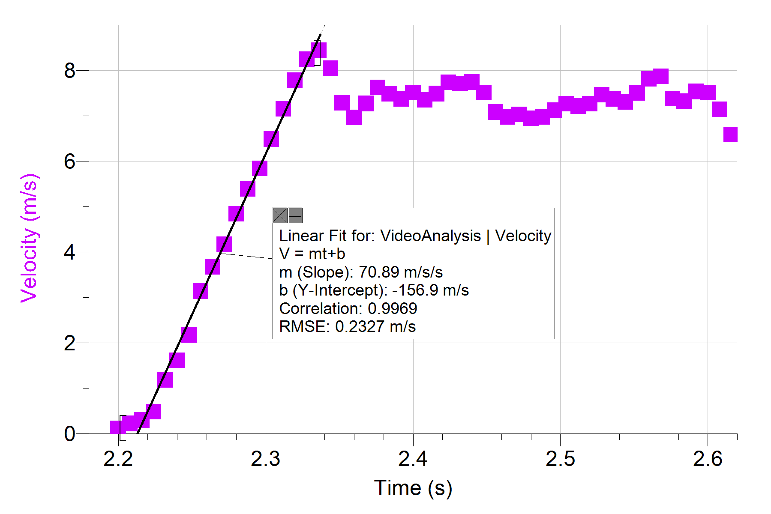
Acceleration

Slide 12
Calculations at release
Max velocity = 8.444 m/s
Mass of dart = 0.016 kg
Force: F = ma = (0.016 kg)(70.89 m/s²) = 1.134 N
Momentum: P = mv = (0.016 kg)(8.444 m/s) = 0.135 N•s
Impulse: I = mΔv = (0.016 kg)(8.444 m/s) = 0.135 N•s

Slide 13
Calculations at release
Kinetic energy: KE = ½ mv² = = 0.570 J
Potential energy: U = mgh = = 0.286 J
Work
W_{x} = Fd_{x} = ma_{x}d_{x} = (0.016 kg) (65.95 m/s²) (0.397 m)
= 0.419 J
W_{y} = Fd_{y} = ma_{y}d_{y} = (0.016 kg) (23.04 m/s²) (0.232 m)
= 0.086 J

Slide 14
Calculations at release
Max velocity = 8.444 m/s
Projection angle:
Vx = VcosΘ
Θ = cos⁻¹ (8.286/8.444)
Θ = 11.10⁰

Slide 15
Comparison of multiple throws
What affects the final position of the dart?
Velocity
Point of release
Release angle

Slide 17
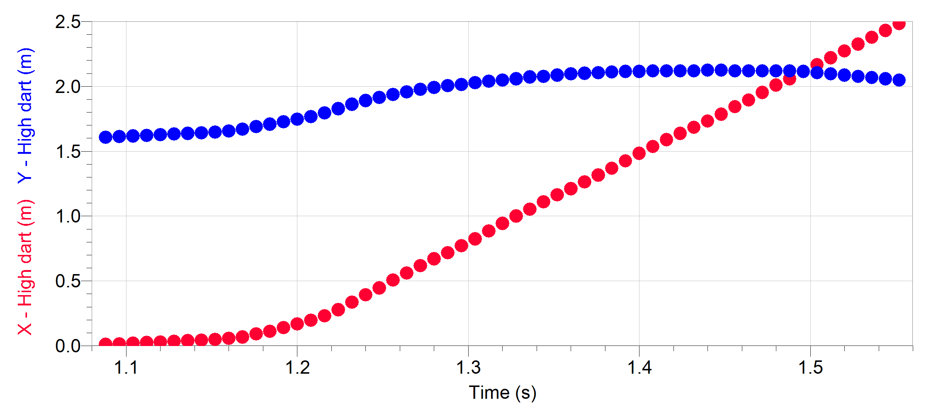
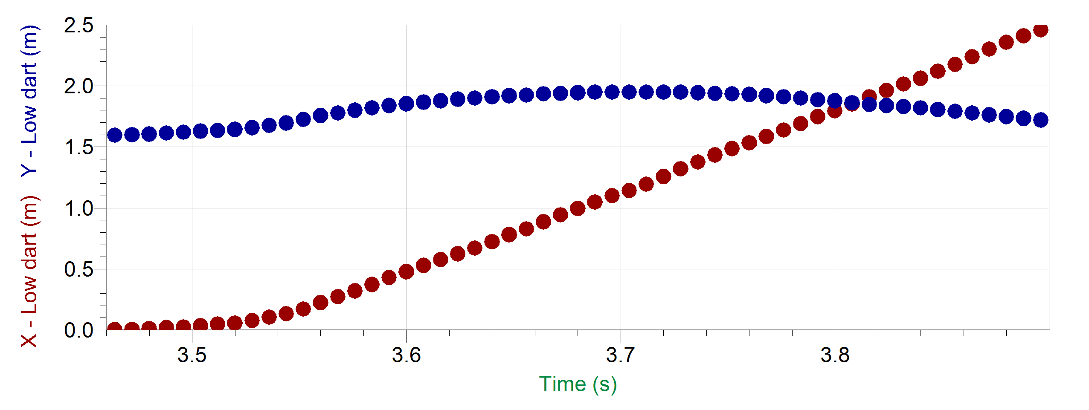
Displacement vs Time
Time = 0.46 seconds
Initial height = 1.61 m
Release point = 1.91 m
Max height = 2.12 m
Final height = 2.05 m
Time = 0.43 seconds
Initial height = 1.60 m
Release point = 1.82 m
Max height = 1.95 m
Final height = 1.72 m

Slide 18
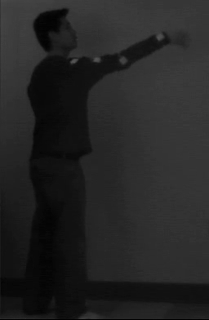
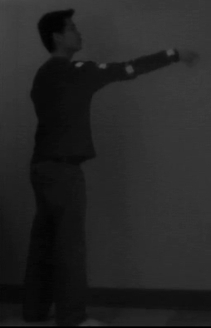
Higher dart throw Lower dart throw

Slide 19
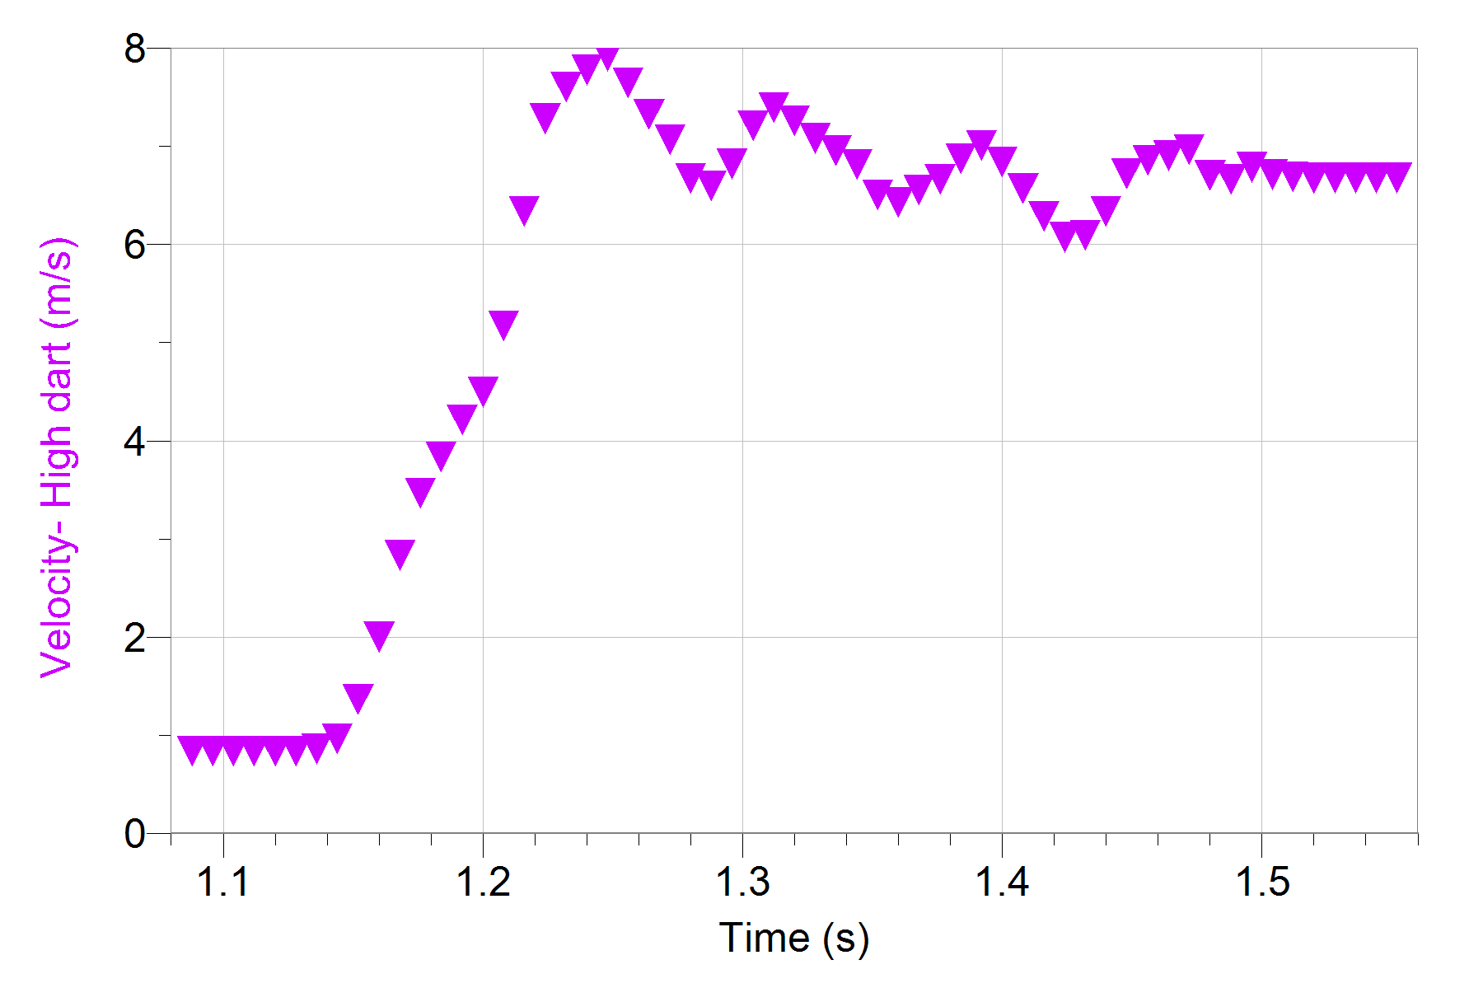
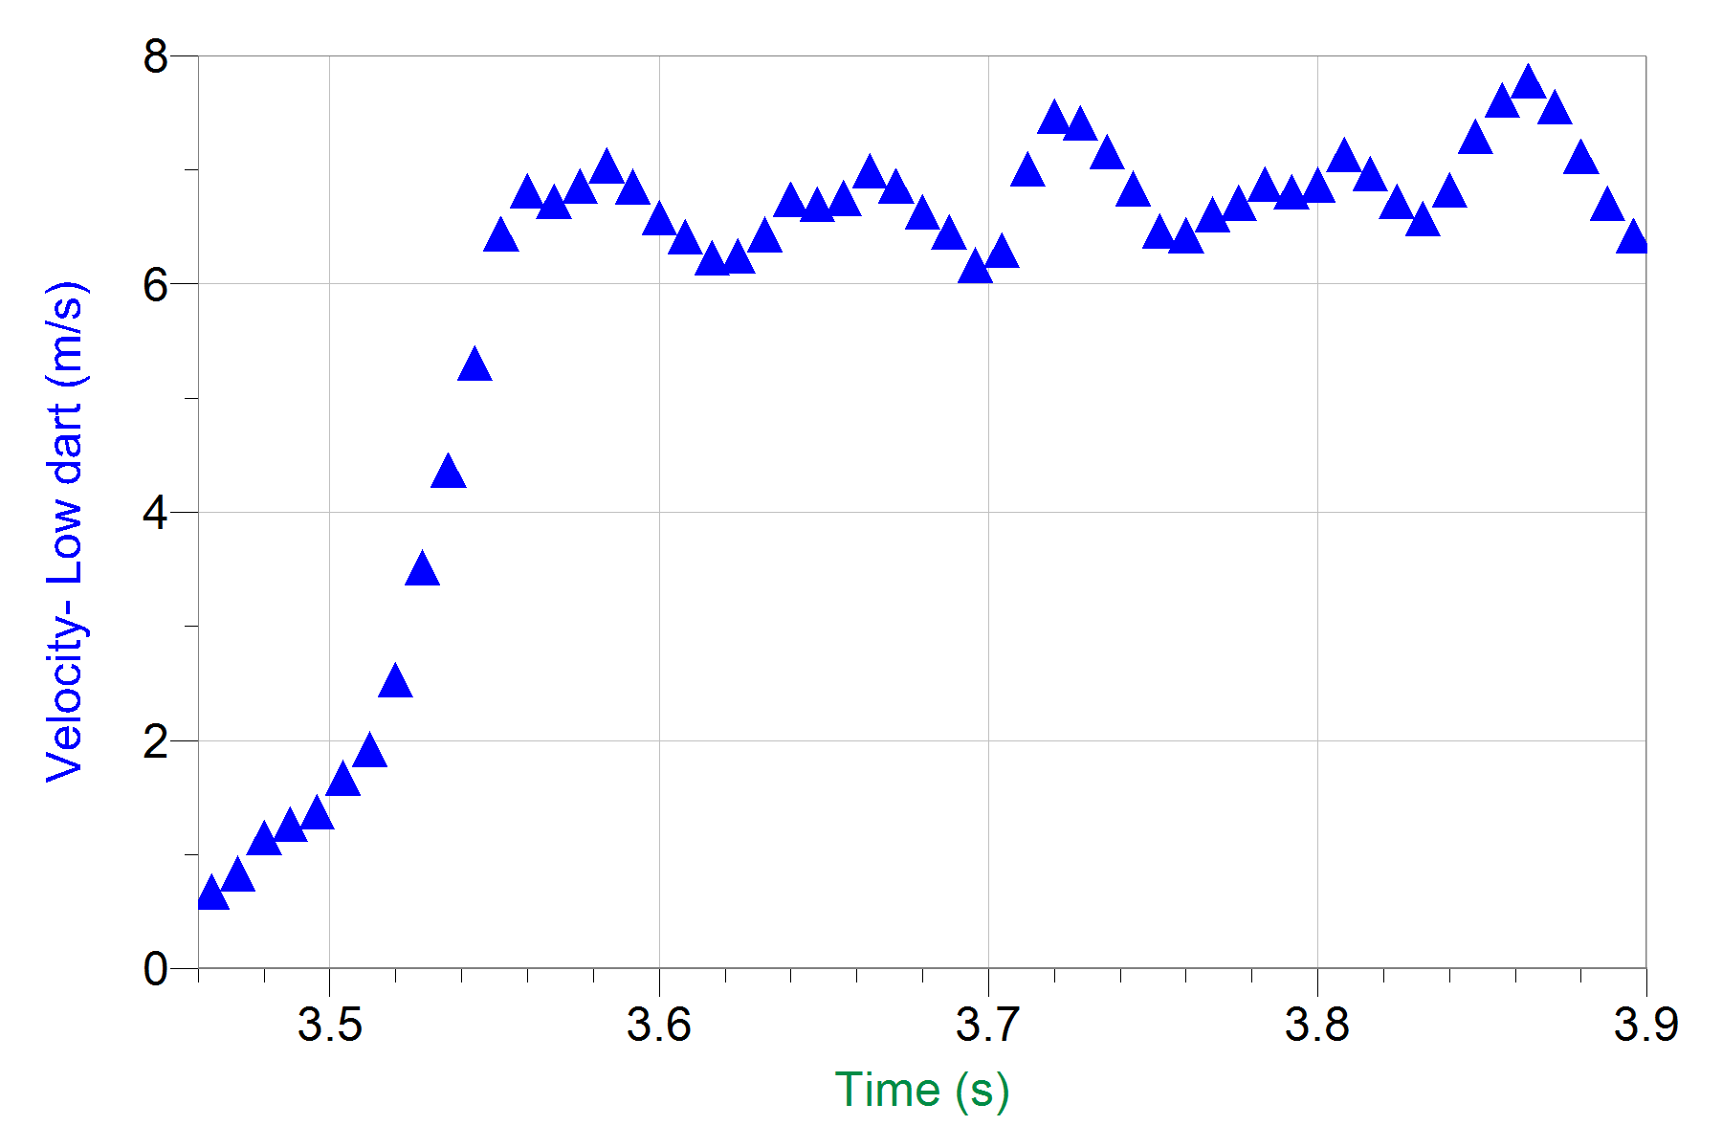
Velocity vs Time
Max velocity of high dart = 7.928 m/s
a = 67.63 m/s²
Max velocity of low dart = 6.977 m/s
a = 63.79 m/s²

Slide 20
Projection angle
Projection angle:
Vx = VcosΘ
Θ = cos⁻¹ (8.286/8.444)
Max velocity of high dart = 7.928 m/s
Θ = 23.99⁰
Max velocity of low dart = 6.977 m/s
Θ = 6.80⁰

Slide 21
Calculations
 | Formula | Higher Dart | Lower dart
Max Velocity | V = √ V_{x}² + V_{y}² | 7.928 m/s | 6.977 m/s
Force | F = ma | 1.08 N | 1.02 N
Momentum | P = mv | 0.127 N•s | 0.117 N•s
Kinetic Energy | KE = ½ mv² | 0.503 J | 0.389 J
Potential Energy | U = mgh | 0.300 | 0.286

Slide 22
Conclusions
Release velocity of higher throws is greater than lower throws
Release point of higher throws is greater than lower throws
Possibly due to more shoulder flexion
Projection angle of higher throws is greater than lower throws
Too many variables to determine which has greatest impact
Need a way to hold other variables constant during testing

Slide 23
Clinical Significance
Ongoing studies researching wrist motion, specifically the dart-throwing motion
Explains how functional abilities in the corresponding planes of motion are affected by disease
Found in everyday activities
Important for rehabilitation
Improve range of motion and strength within the plane of motion
Notes:
Hammering, pouring water, combing your hair

Slide 24
References
Crisco JJ, Coburn JC, Moore DC, Akelman E, Weiss AP, Wolfe SW. In vivo radiocarpal kinematics and the dart thrower's motion. J Bone Joint Surg Am. 2005 Dec;87(12):2729-40.
“Darts.” Wikipedia. <http://en.wikipedia.org/wiki/Darts>
Lenn, Jay D. (2012) Mapping the dart thrower’s arc. AAOS Now. January 2011 Issue.
Orthogate. <http://www.orthogate.org/patient-education/hand/guyons-canal-syndrome.html>
Shoulder articulations. <http://www.exrx.net/Articulations/Shoulder.html>

