Slide 1
Comparative Efficacy and Physiology of Front and Back Leg Kicks
Ruchita Pendse
April 5, 2015
Biol 438 Project Presentation

Slide 2
The Real-World Problem
Martial arts + combat
End goal: Damage to the opponent/attacker
Power of Strike
Probability of Hitting Target
Instantaneous optimization decisions are constantly being made

Slide 3
Question
How do front and back-leg kicks differ in their ability to harm an opponent, and what is the underlying physiology of those differences?

Slide 4
Methods
How do we measure “damage”?
Impulse: change in momentum; integral of Force w/r to time
Proxy for direct measurement of force: projectile motion
Initial velocity over time of contact with ball → acceleration → force
Video
Sony Cybershot RX10 II at 480fps
Markers on joints of interest
Six trials of each kick
Analysis
Logger Pro software for video analysis

Slide 5
Methods: Video Setup
Back Leg Stance
Front Leg Stance

Slide 6
Back Leg Kick

Slide 7
Front Leg Kick

Slide 8
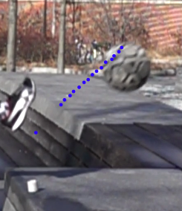
Analysis
Question 1: What is the difference in impulse delivered by the two kicks?
F applied
F drag (negligible)
F gravity
Determine velocity of the ball after it leaves the foot
Determine duration of contact with the ball
Mass of ball = 0.43 kg

Slide 9
Results
Average applied force
Back Leg: 235 N
Front Leg: 186 N
Back leg kick delivers about 30% more force
Average impulse
Back Leg: 4.9 N s
Front Leg: 4.0 N s
→ Back leg delivers about 25% greater relative impulse

Slide 10
Analysis
Question 2: What is the difference in the speed and predictability of the two kicks?

Slide 11
Results
Time from start of kick initiation to contact
Back leg: 0.66 seconds
Front leg: 0.61 seconds
Surprisingly small difference
Duration of kick does not matter as much as physiological “projection”

Slide 12
Analysis
Question 3: What physiological differences are responsible for the different impulses delivered by the two kicks? How might this affect projection?

Slide 13
Foot momentum

Slide 14
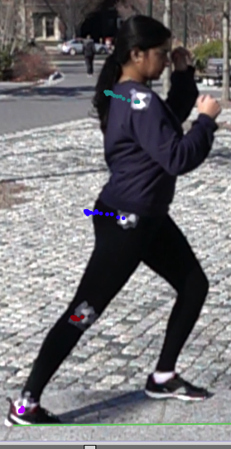
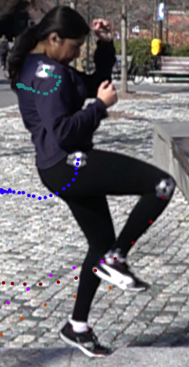
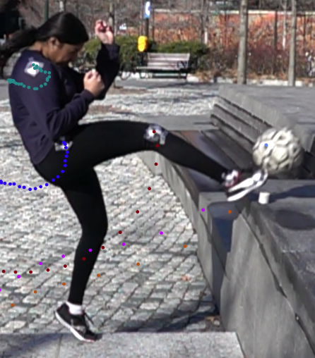
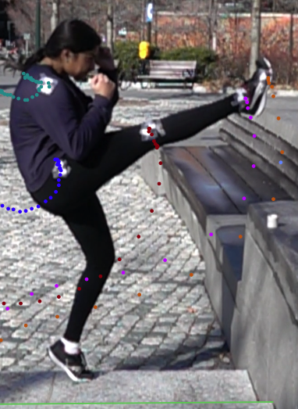
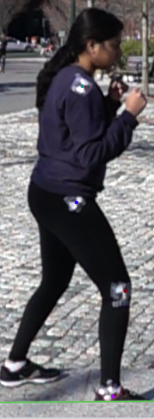
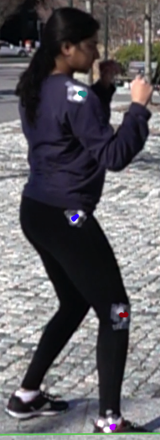
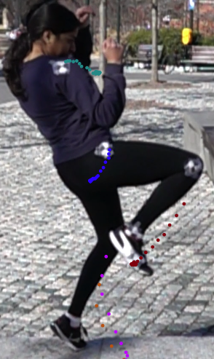
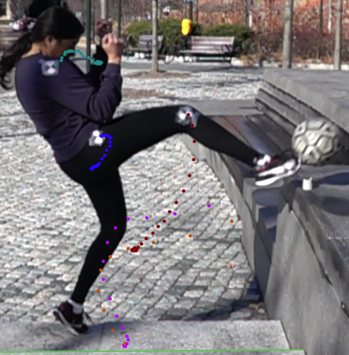
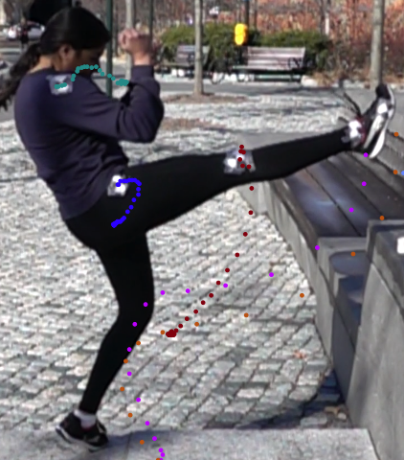
Stages of a Kick
Back Leg
Front Leg

Slide 15
Back leg kick trajectory

Slide 16
Front leg kick trajectory

Slide 19
Key Conclusions
Back leg kick was able to deliver a stronger impulse
Longer drive creates higher velocity of impact
More straight approach allows more mass to be behind the strike
These results would be expected to be more pronounced with heavier targets
Actual duration of the two kicks was quite similar
Key physiological differences result in the back leg kick projecting much earlier
Back hip drops and moves forward in back leg kick

Slide 20
Stages of a Kick
Back Leg
Front Leg

Slide 21
Limitations
The soccer ball is a decent “force plate” but a poor target
No rotational (twisting) component
Assumptions
No forces acted on the ball in the first 10 frames
Drag is insignificant
Did not look at rotation of the ball itself

Slide 22
Future Directions
More ideal target/force plate?
Frontal analysis to evaluate projection
Angular analysis around each joint
Accuracy of kicks
Different types of kicks

Slide 23
References
“Body Segment Data.” Kinesiology Calculations. ExRx.net. Web. 03 Apr 2016.
“Momentum and Its Conservation.” Physics Tutorial. The Physics Classroom. Web. 03 Apr 2016.
Questions?

