Slide 1
Biomechanics and Health Risks of Pitching
Liz Tucker
Dr. Rome
Biol 438

Slide 2
Introduction
Complex coordination of staged motion.
Requires fluidity, balance, timing and coordination to result in a violent and explosive movement of the pitching arm.
The repetitive and violent motion leads to long term wear of pitching joints, as well as more acute injuries.
The type of pitch relied upon by a pitcher increases their risk of injury.
Goal: Analyze differences in torque in joints in three pitches and how they relate to injury.

Slide 3
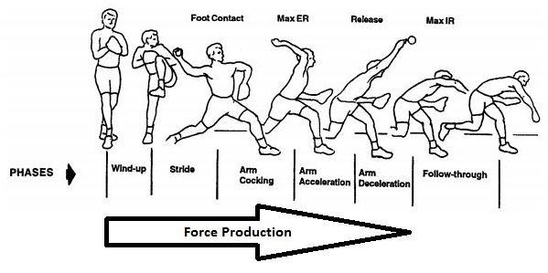
Stages of the Pitching Motion

Slide 4
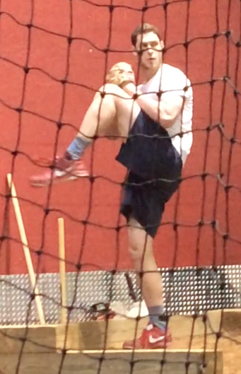
Wind Up
Starts with lead leg planted on the ground and ends when lead leg reaches maximum height.
Focus is to keep center of gravity on back leg to ensure collected and rapid transfer of motion through the pitch.
Muscles engaged: quadriceps, glutes, lats, abdominals, calves

Slide 5
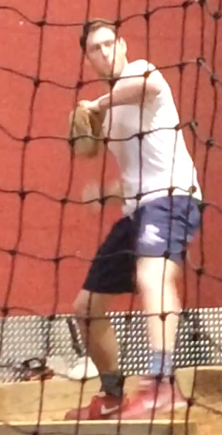
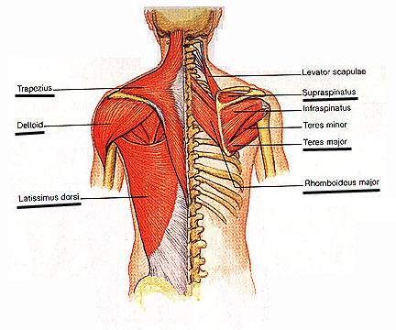
Stride
Begins when leg begins to lower as ball is removed from glove. Ends when lead foot is firmly planted on the ground.
Pelvic and torso rotation occur as the shoulders tilt downwards.
Muscles engaged: deltoid, rotator cuff, traps, lats, glutes
Notes:
http://jessbanda.files.wordpress.com/2009/08/rotators.jpg
http://www.discussfastpitch.com/kens-softball-tips/1910-using-big-muscles-pitching.html

Slide 6
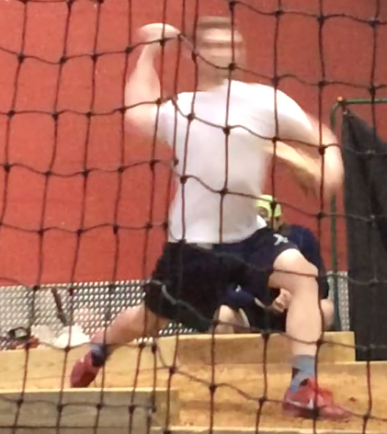
Arm Cocking
From planting of lead foot to maximal external rotation of the throwing shoulder.
Ball is raised above and behind the head, while the pelvis reaches its full rotation.
Muscles engaged: similar muscles to that of the stride, biceps, pecs, lats.

Slide 7
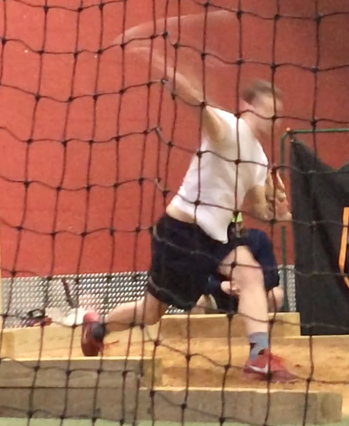
Arm Acceleration
From max external rotation of the shoulder to when the ball is released.
Elbow extends as the shoulder adducts horizontally.
Wrist flexion occurs before release depending on the pitch.
Ball is released when the forearm is perpendicular to the ground as trailing leg leaves the ground.
Muscles used: pecs, lats, subscapulari, triceps, wrist flexors, abdominals…

Slide 8
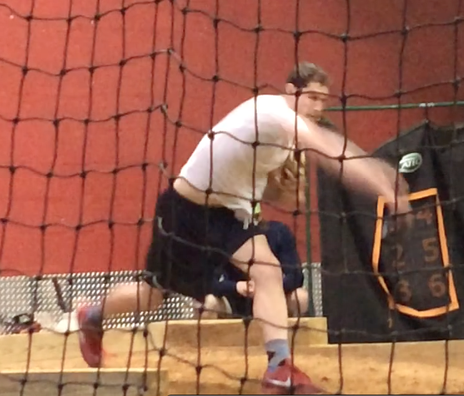
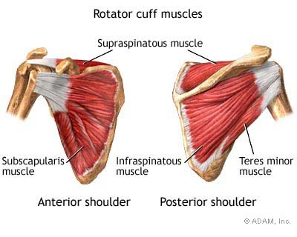
Arm Deceleration
Occurs between ball release and max humeral internal rotation and elbow extension.
Most violent stage of the cycle
The muscles in the back of the shoulder must rapidly contract to decelerate the arm
Muscles used: Rotator cuff muscles, biceps, traps, rhomboids, teres major.

Slide 9
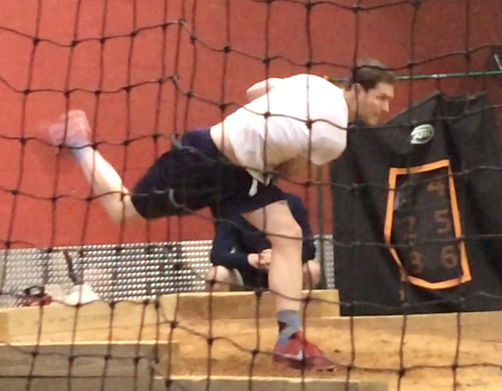
Follow Through
Arm motion stops as the body continues to adjust and slow down ends when the trailing leg meets the ground.
Leg raises to stabilize the body so that the pitcher does not fall uncontrollably forward.
Muscles used: same muscles as deceleration, quads, claves.

Slide 10
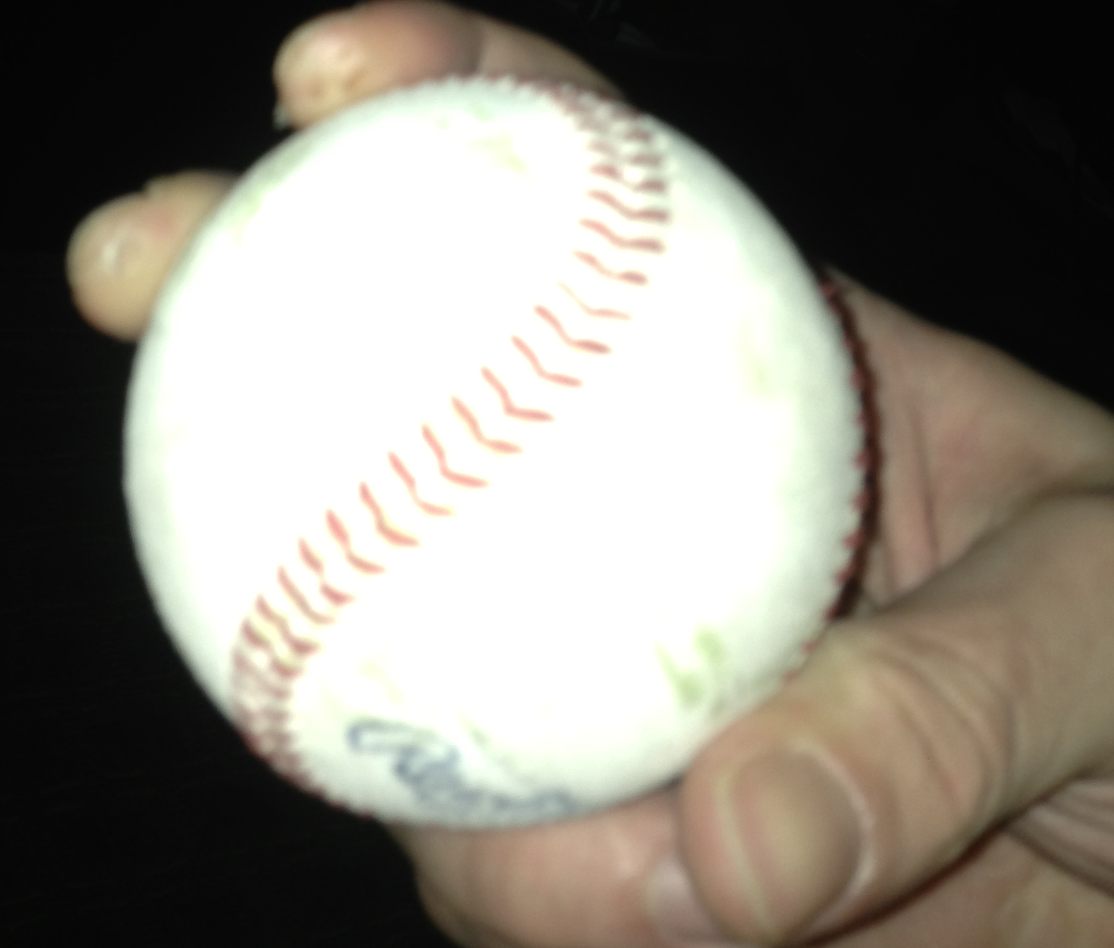
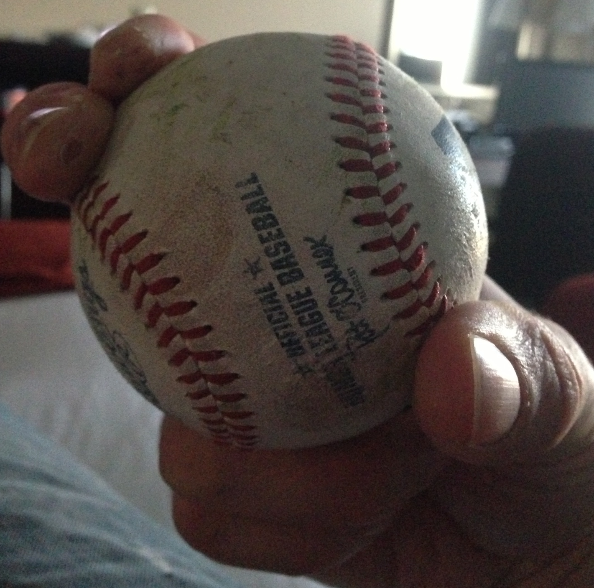
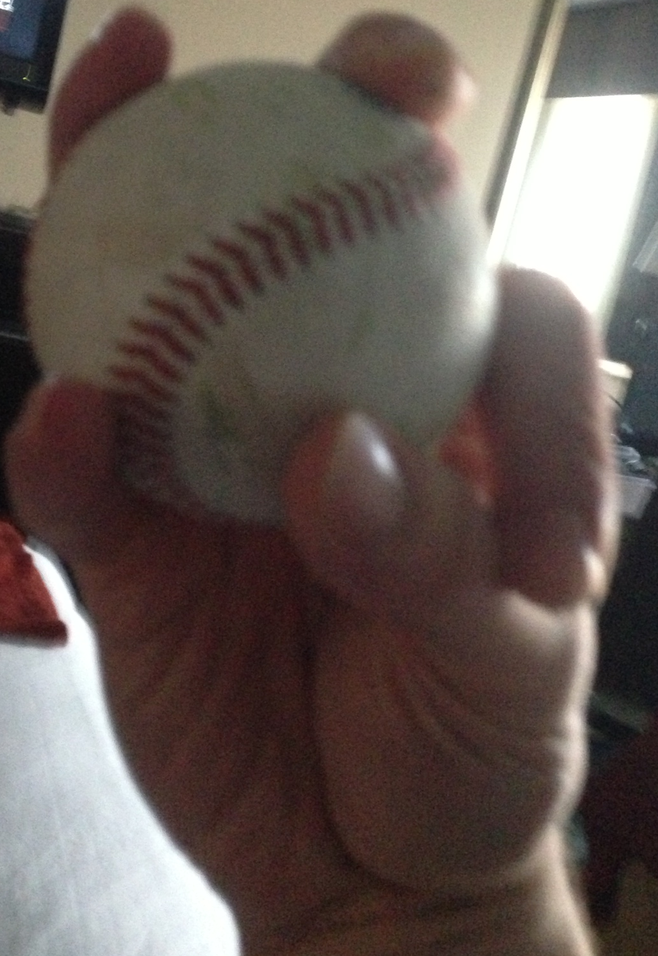
Three Pitches
Fastball
Thrown for speed
Wrist flexion and grip cause backspin on the ball
Curveball
Thrown for movement
Desire a 12’-6’ drop caused by forward spin
Change up
Off speed pitch
Grip and position of ball in palm decrease velocity

Slide 11
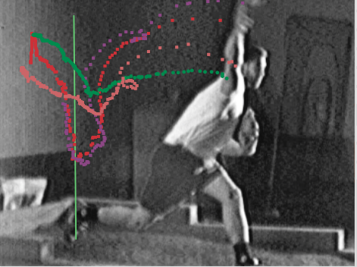
Methods
Center of mass established for upper arm, forearm, and hand
X= position of proximal joint + center of mass for the segment (constant) (position of distal joint – position of proximal joint
Y= position of proximal joint + center of mass for the segment (constant) (position of proximal joint- position of distal joint)
X and Y velocities and accelerations- logger pro.
Net velocities and accelerations were acquired by taking the change in the added vectors between each of the time points.
The average velocity over the Arm Acceleration was used to calculate the Force

Slide 12
Fastball
Force = ma
Upper arm- (segment weight/ total body weight)* Body weight + mass of the ball)* Average Acceleration
(97.5225Kg*0.028+0.142Kg)*27.311m/s²= 78.453N
Forearm- (0.016*97.5225kg+0.142Kg)*34.161m/s²= 258.155 N
Wrist- (0.006*97.5225Kg*.142Kg)*90.288m/s²= 65.652 N
Total measured* force from arm on ball- (0.05*97.5225Kg+0.142Kg)*90.288m/s²= 453.078 N
Torque= F_{A}*r (distance from center of mass to the joint)
Upper arm= 78.453 N* .561 m= 44.007 N*m
Forearm= 58.155 N * .293 m= 58.448 N*m
Wrist= 65.652 N *.092 m= 6.063 N*m

Slide 13
Fastball Cont.
Work= Force * Distance
Upper arm- Force_{UA Acc} N* Σ_{displacement of UA} (sqrt (x₂-x₁)^2+ (y₂-y₁)^2)=66.325 J
Power= Work/ time
Upper arm- 66.325 J /.320 s= 207.269 Watts

Slide 14
Summary
 | Acceleration |  |  |  |  |  |  |  |  | Deceleration
 | Torque (N*m) |  |  | work (J) |  |  | power (Watts) |  |  | Torque (N*m) |  |  | work (J) |  |  | power (Watts)
 | u. arm | F. arm | wrist | u. arm | F. arm | wrist | u. arm | F. arm | wrist | u. arm | F. arm | wrist | u. arm | F. arm | wrist | u. arm | F. arm | wrist
Fastball | 44.01 | 58.45 | 6.06 | 66.24 | 66.33 | 133.60 | 207.27 | 207.00 | 417.51 | 33.33 | 19.22 | 2.55 | 70.13 | 108.86 | 54.21 | 184.56 | 286.48 | 142.65
Curve | 28.86 | 8.34 | 5.13 | 42.92 | 30.22 | 84.19 | 130.07 | 91.56 | 255.11 | 43.89 | 12.17 | 2.75 | 40.92 | 49.45 | 27.61 | 206.65 | 249.75 | 139.46
Changeup | 109.31 | 41.65 | 6.94 | 182.04 | 186.92 | 139.23 | 455.09 | 467.29 | 348.06 | 98.18 | 42.61 | 7.02 | 92.63 | 168.54 | 128.40 | 367.59 | 668.83 | 509.51
Work done on the ball:
Fastball: 922.0 J
Curve: 682.2 J
Change up: 960.8 J
Interesting to note where more work is done in the deceleration.
This is actually where the most damage is done.

Slide 15
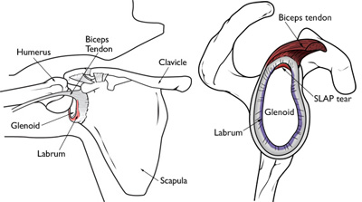
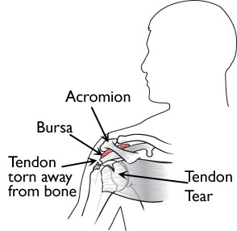
Shoulder Injuries
SLAP tears
Superior labral tear from anterior to posterior
tear where the biceps tendon meets the Labrum
Biceps tendinitis and tears
Rotator cuff tendinitis and tears

Slide 16
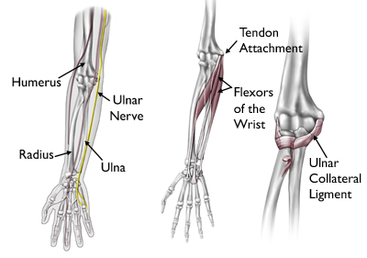
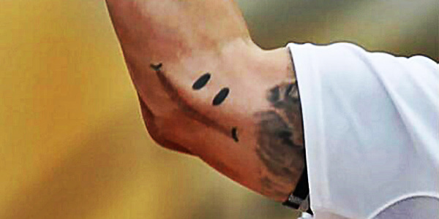
Elbow Injuries
Happen gradually
Flexor Tendonitis
Irritation of the tendons
Ulnar Collateral Ligament (UCL)
Minor damage to tear
Tommy Johns
Valgus Extension Overload
Degeneration of cartilage
Bone spurs

Slide 17
Future Research
Get more samples.
Integrations of all body parts into a kinetic chain.
Re-film from different angles in order to quantify the rotation of the humerus.
Film so that the way grip affects ball spin and rotation.

Slide 18
References
American Academy of Orthopedic Surgeons. “Elbow Injuries in the Throwing Athlete.”March 2013. http://orthoinfo.aaos.org/topic.cfm?topic=A00644.
American Academy of Orthopedic Surgeons. “Shoulder Injuries in the Throwing Athlete.”March 2013. http://orthoinfo.aaos.org/topic.cfm?topic=A00635.
Seroyer et Al. “The Kinetic Chain in Overhand Pitching: Its Potential Role for Performance Enhancement and Injury Prevention.” Sports Health: A Multidisciplinary Approach. March/ April 2010. vol. 2. No. 2 Pages 135-146. http://www.ncbi.nlm.nih.gov/pmc/articles/PMC3445080/.
Winter, David. “Biomechanics and Motor Control of Human Movement.” Ontario: John Wiley & Sons. 2005.

